Slide 1


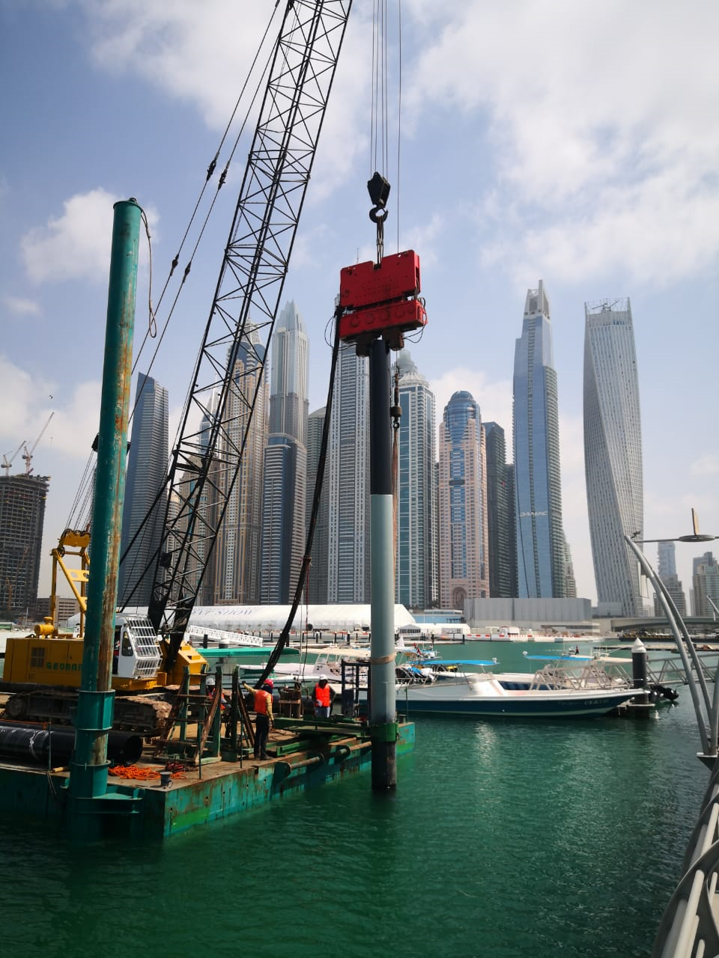

Slide 2
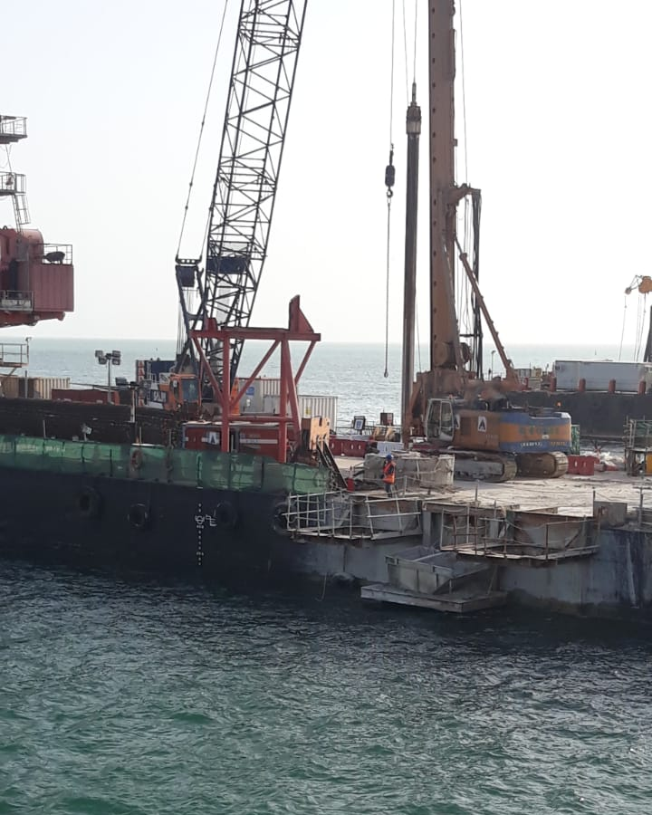
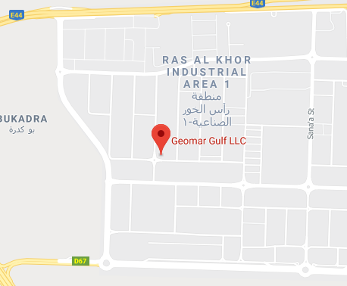
CONTACT US
GEOMAR GULF LLC
PO BOX 122801
DUBAI UAE
TEL: +971 4 320 98 97
FAX: +971 4 320 90 09
MAIL : info@geomargulfllc.com
www.geomargulfllc.com

Slide 3
TABLE OF CONTENTS
01
COMPANY ACTIVITIES
02
PLANTS & MACHINERY
03
UNIQUE PROJECTS
04
REGISTRATION & CERTIFICATION
INTRODUCTION
05

Slide 4
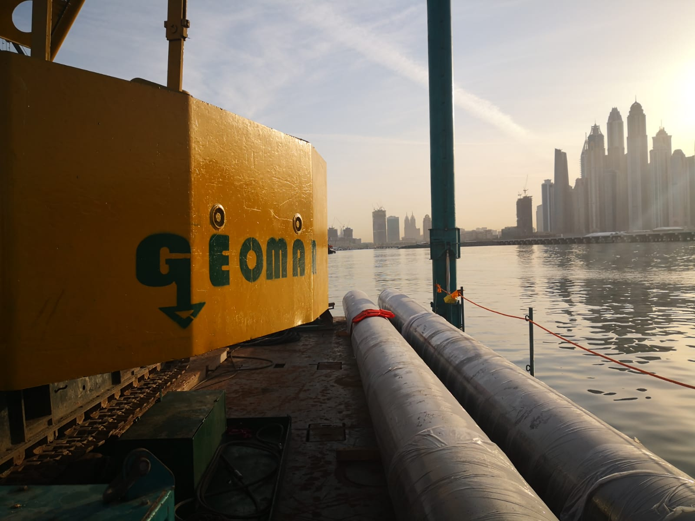
ABOUT US
INTRODUCTION
Established in UAE since 2004, Geomar Gulf LLC has been involved in several projects in both design and execution stages since its foundation and took its place as one of the well-known piling companies in Dubai.
Since establishment and with our partnership with Al Shafar Group, Geomar Gulf LLC have completed projects in the public and private sectors all over UAE.
As we become one of the leading piling contractor in UAE, we have expanded our capabilities to cater the market’s need in piling and foundation works, we have engage in the Marine works and completed several offshore piling works.
As Geomar Gulf LLC we are commercial license Holder for
Piling and Foundation Contracting
Ports and Marine Construction Contracting

Slide 5
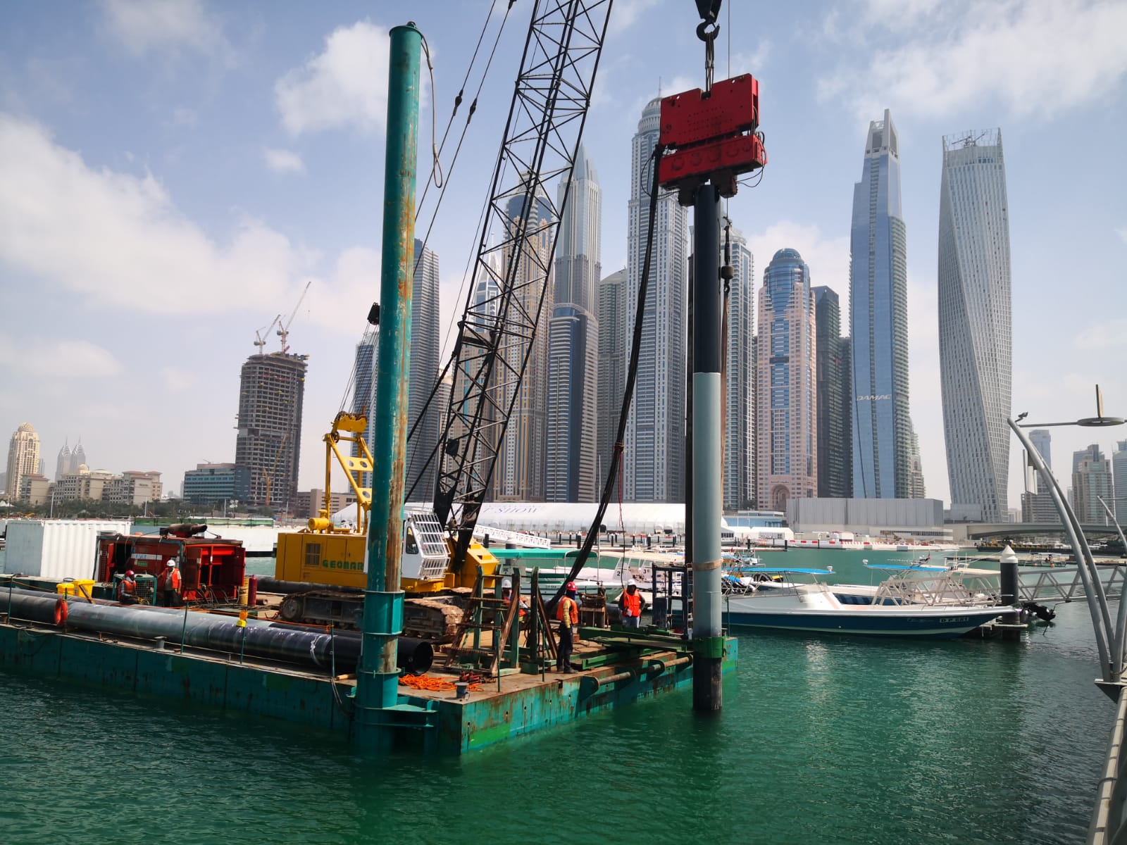
OUR PHILOSOPHY
MISSION
VISION
VALUES
Geomar Gulf LLC is dedicated to providing quality construction and technical services to our customers. We will strive to implement long term relationship with our clients, based on safety, quality, timely service and an outlook on their needs.
Our vision is to be ranked among the leading foundation specialists in GCC Region. We aim to be unique with our projects, creative with our approach and dynamic with serving our clients, as we maintain our sustainable growth as a business.
Our uncompromised values are integrity, diligence, teamwork, permanence and commitment. Where our strengths are competitive pricing, quality assurance, on-time delivery, innovative solutions, forward planning and long-term thinking.

Slide 6
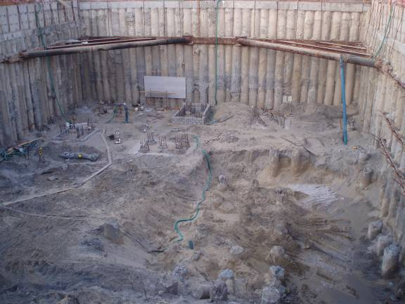
COMPANY
ACTIVITIES
Piling and Shoring Activities
Shoring Systems
Shoring with soldier steel profiles
Diaphragm wall with mechanical grab
Shoring system with secant piles
Shoring with sheet piles
Shoring system with contiguous piles
2
1
3

Slide 7
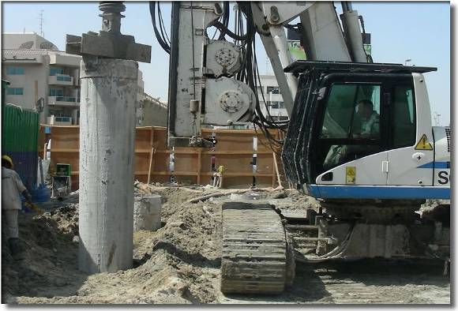
COMPANY
ACTIVITIES
Piling and Shoring Activities
Pile Foundations
Bored cast in situ piles
Driven piles
Continuous flight auger (CFA) piles
Cast in situ driven piles
Mini piling
2
1
3

Slide 8
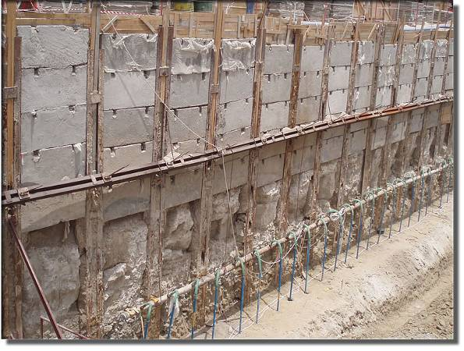
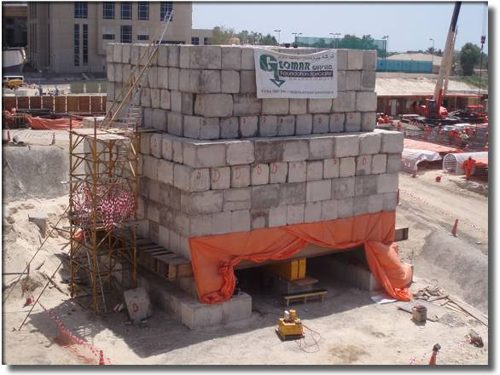
COMPANY
ACTIVITIES
Foundation Activities
2
Soil Improvement
Jet grout
Ground Anchors
Permanent
Temporary
Instrumentation, monitoring, and testing
1
3

Slide 9
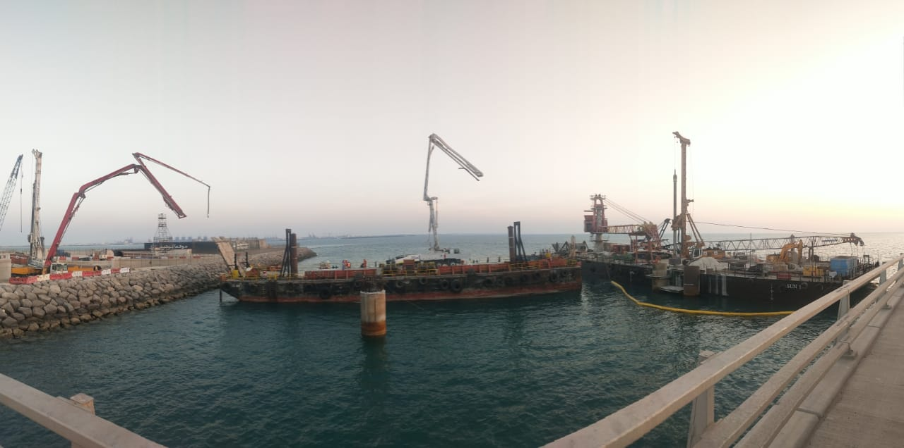
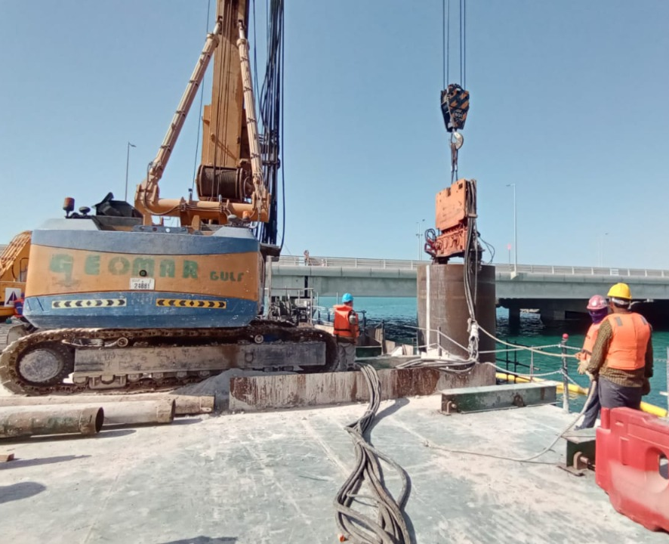
COMPANY
ACTIVITIES
Ports and Marine Construction Activities
Piling and Shoring works
Cast in-situ piles
Steel tubular piles
Wooden/timber piles
Sheet piles
Soldier piles
Load Tests
Vertical Load Test
O-Cell Load Test
2
1
3

Slide 10
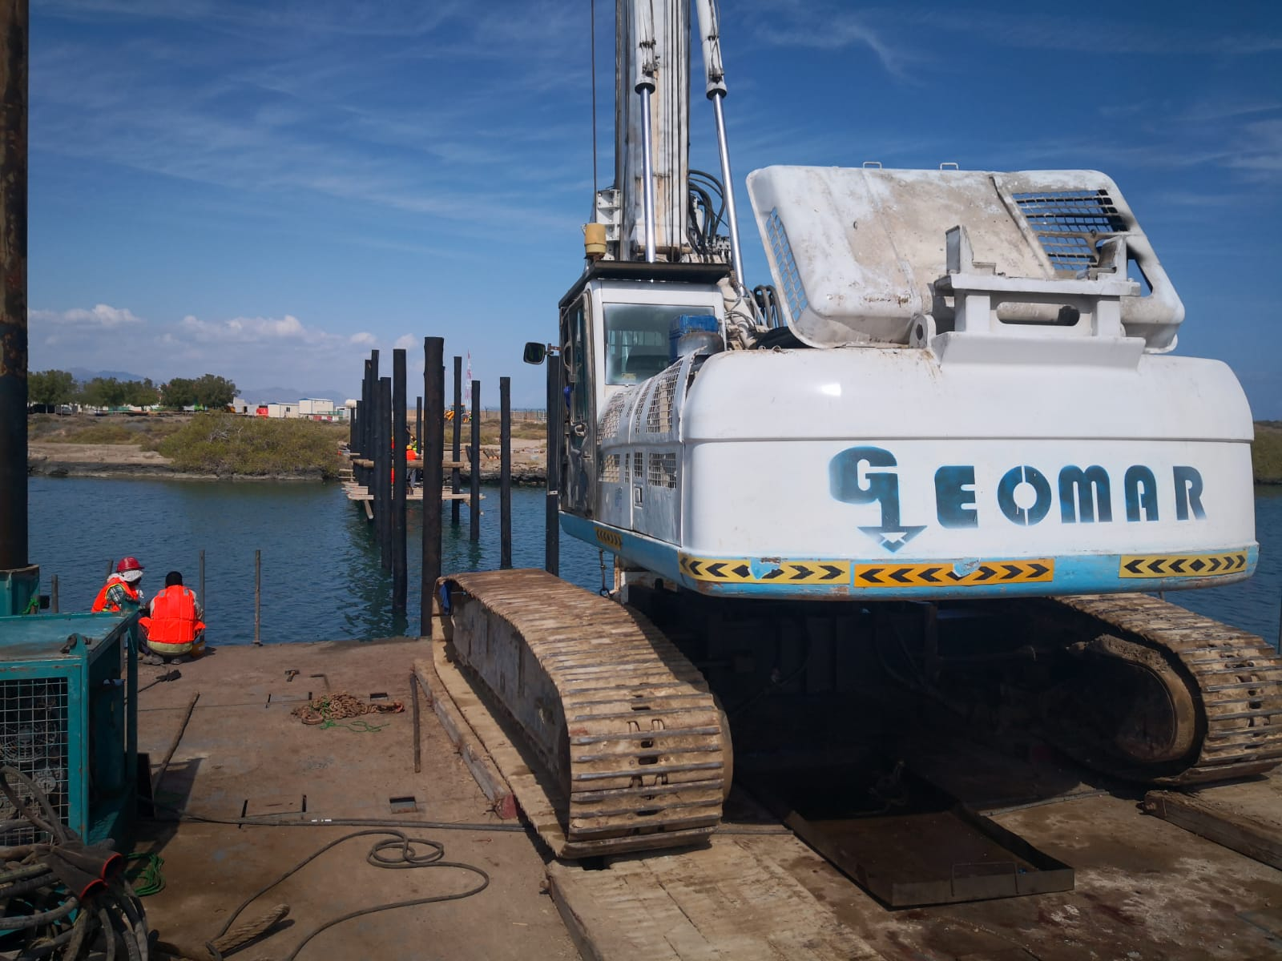
COMPANY
ACTIVITIES
Ports and Marine Construction Activities
Installation and Demolition works
Pontoon and gangway installation, transportation.
Buoy installation, maintenance
All kinds of demolition, removal. extraction works in marine.
2
1
3

Slide 11
PLANTS &
MACHINERY
Drilling Rigs
Bauer BG36
Soilmec SR100

Slide 12
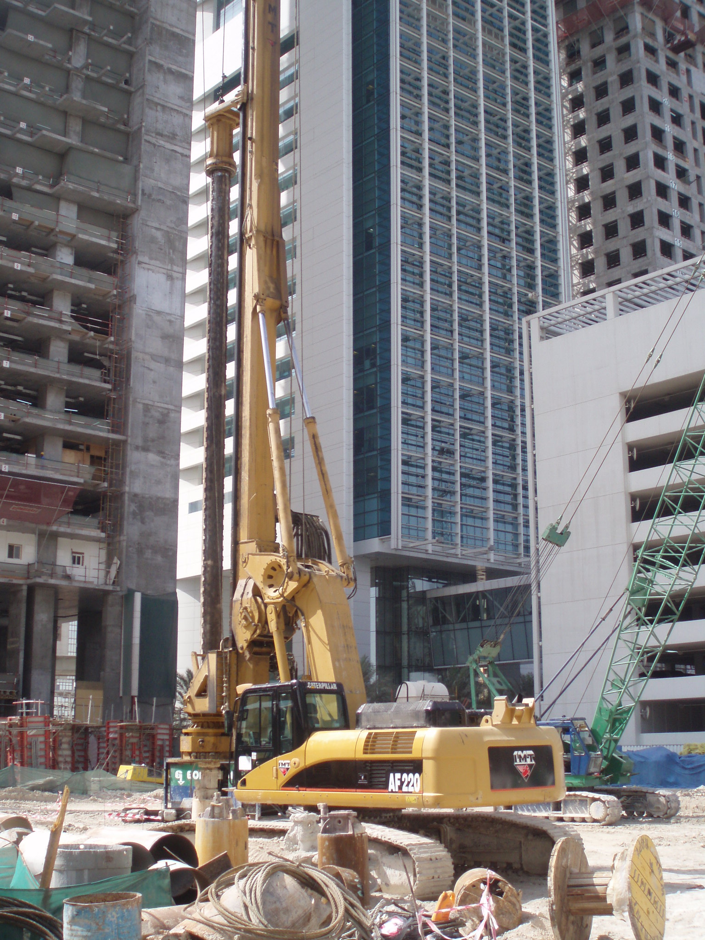
PLANTS &
MACHINERY
Drilling Rigs
IMT AF220
Soilmec R825

Slide 13
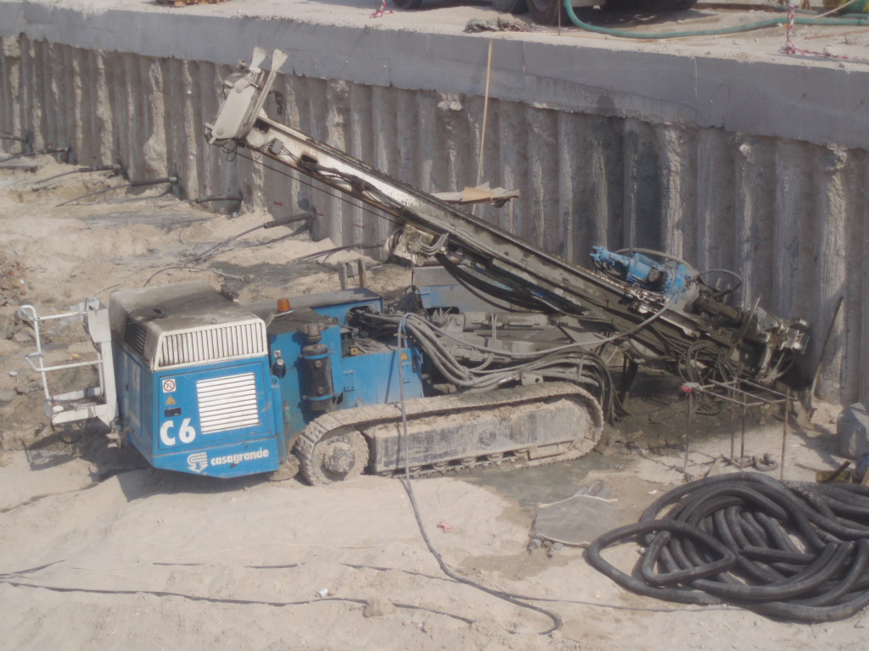
PLANTS &
MACHINERY
Drilling Rigs
Soilmec R620
2 NO
Casagrande C6

Slide 14
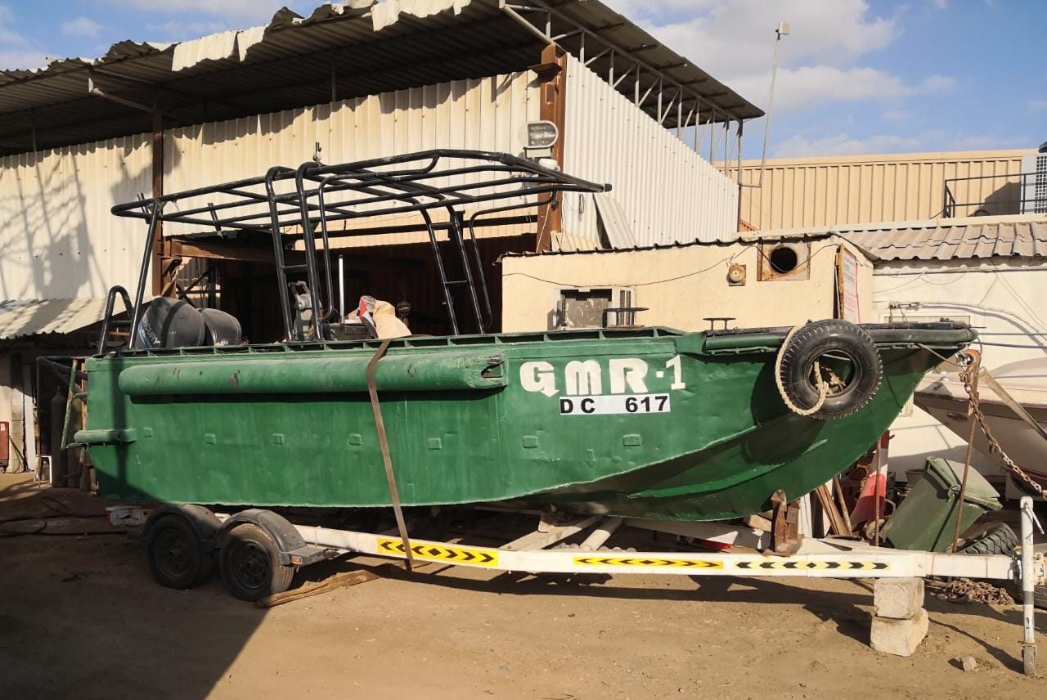
PLANTS &
MACHINERY
MODULAR SPUD BARGE & TUG BOAT

Slide 15
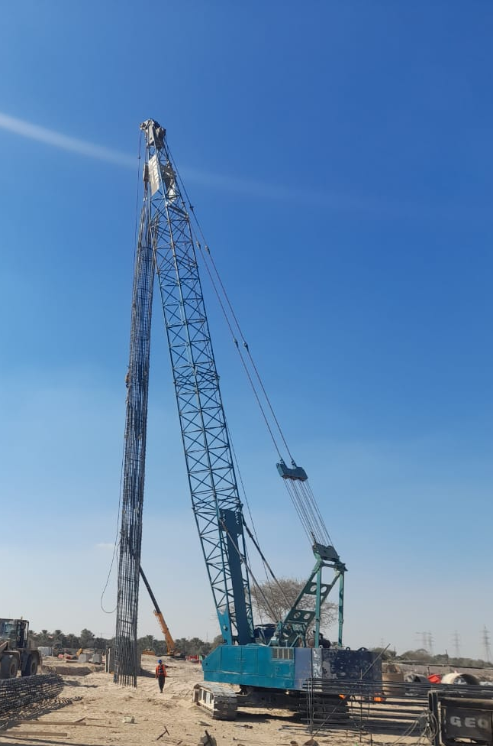
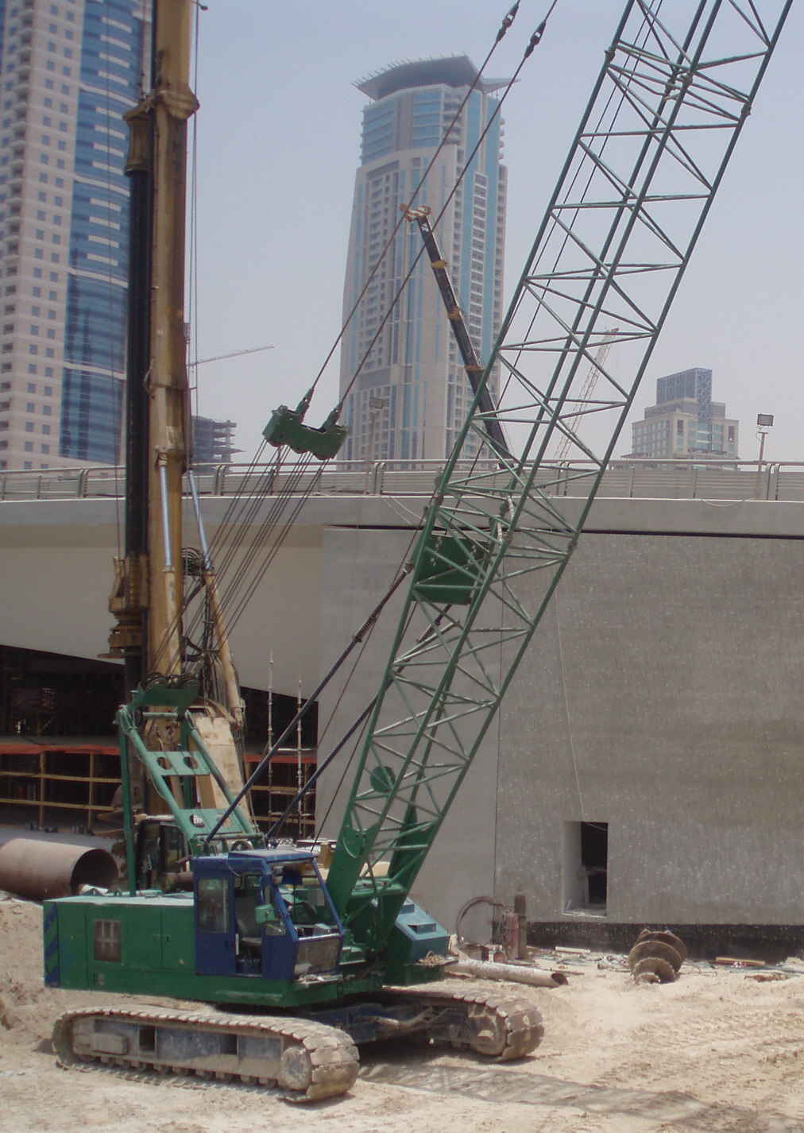
PLANTS &
MACHINERY
Crawler Cranes
Sany SC500D
NCK Raiper
Samsung Hitachi CX500 - 2 NO
RBC H40

Slide 16
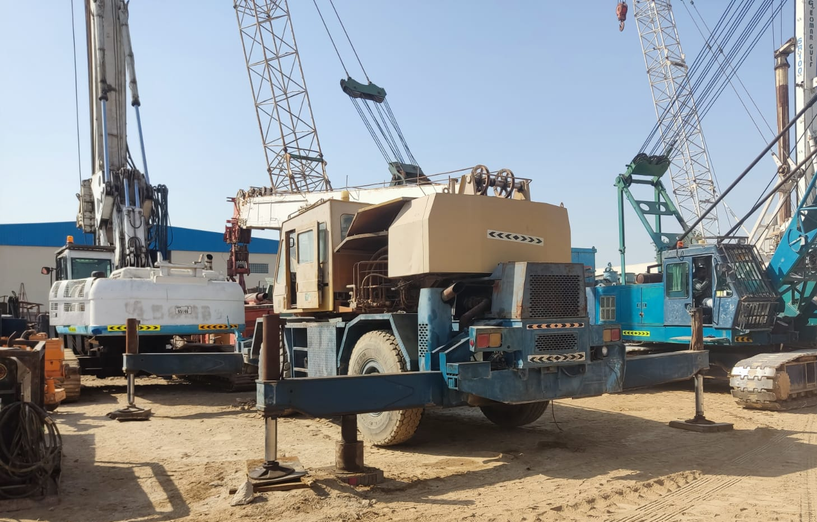
PLANTS &
MACHINERY
Mobile Cranes
Tadano GR-300EX
Hyundai HC50

Slide 17
PLANTS &
MACHINERY
Hammers
PTC 50HD2L
Vibro-Hammer
PTC 30H1 Vibro-Hammer – 2 NO
Starke HD30
Diesel-Hammer
Delmac D46 - 32
Diesel-Hammer

Slide 18
PLANTS &
MACHINERY
General Construction Machines
CAT 324D
CAT 3938G

Slide 19
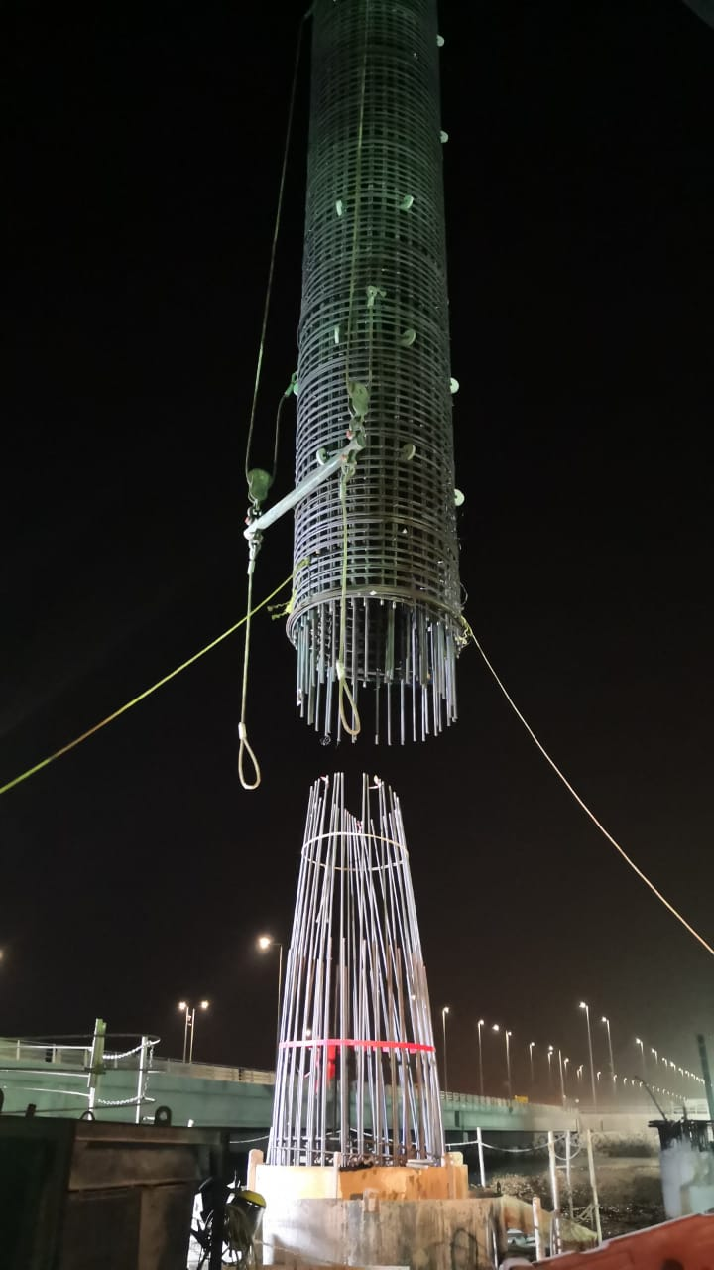
UNIQUE PROJECTS
Etihad Rail 2F2 – Khalifa Port Marine Bridge
Scope : Offshore Cast in-situ Piles with 2200mm diameter, 36 m depth with 37 ton steel cage
Client: Etihad Rail
Consultant: Jacobs
Sub-Consultant: Systra
Main Contractor: L&T PC JV

Slide 20

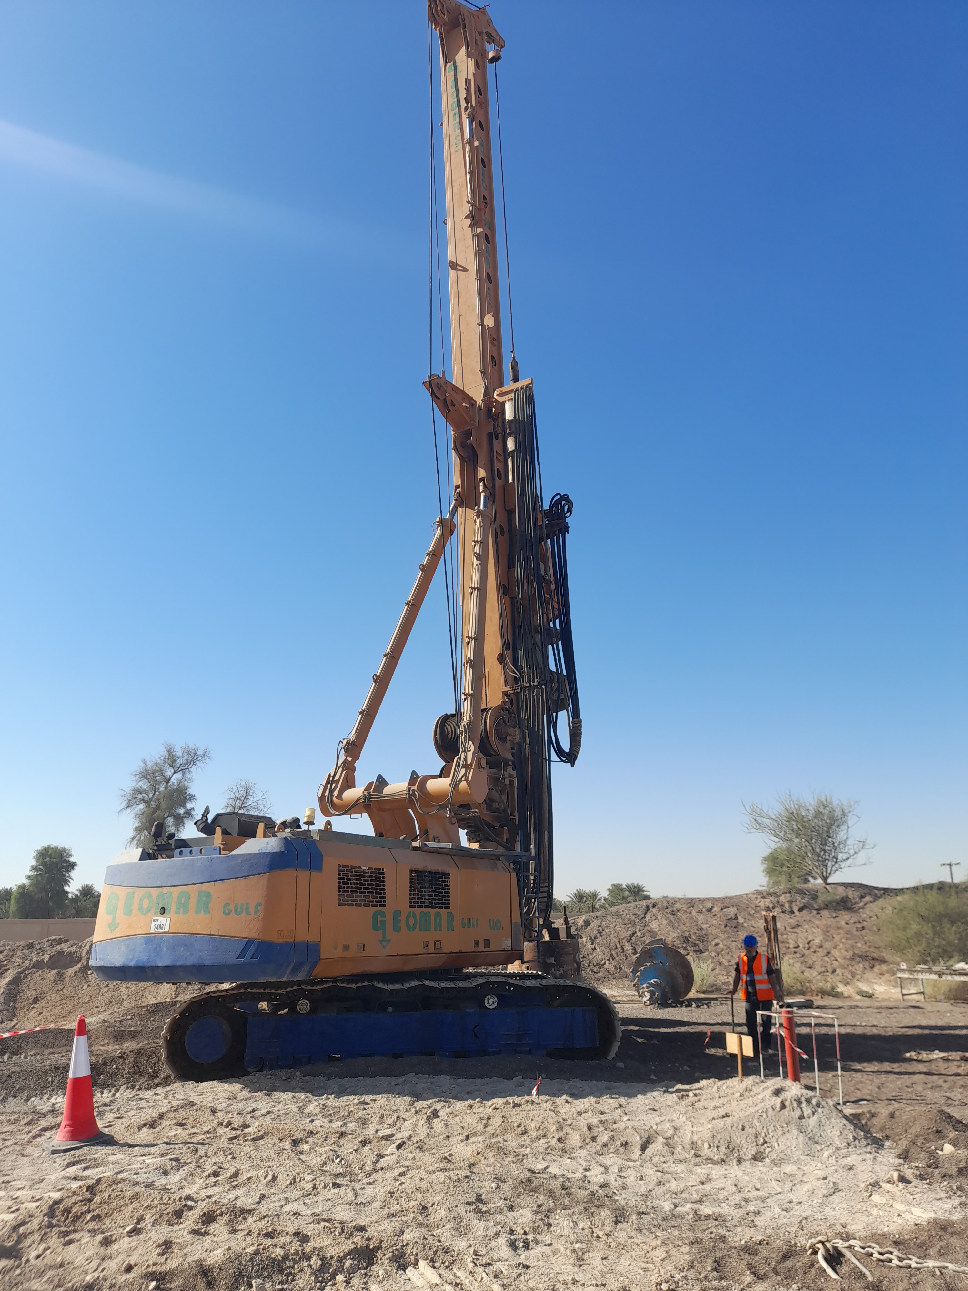
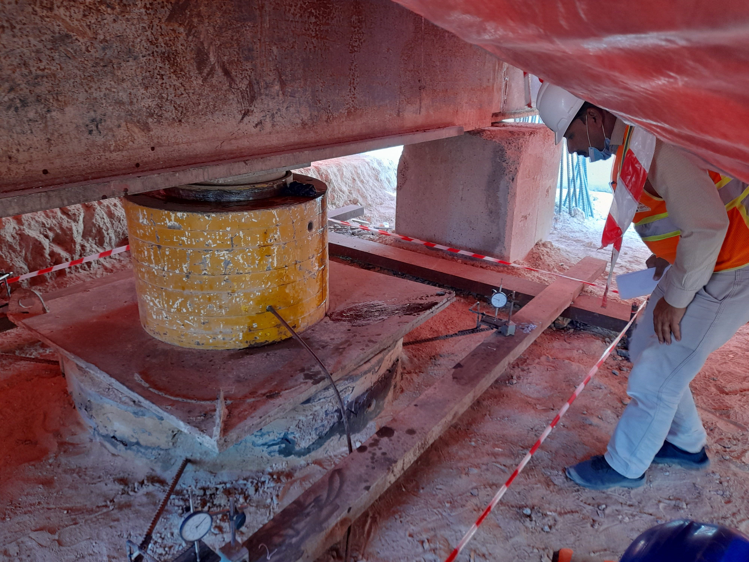
UNIQUE PROJECTS
Etihad Rail 2D – Sharjah to Fujairah
Scope : Cast in-situ Piles with 1500 mm diameter, into hard rock
Client: Etihad Rail
Consultant: Jacobs
Sub-Consultant: Systra
Main Contractor: CRCC

Slide 21
UNIQUE PROJECTS
Dubai Harbour Marina
Scope :Supply and installation on steel tubular piles 660mm dia. piles. Installation of Pontoons, Gangways, Buoys and HDPE sleeves.
Client: Emaar, Shamal Development, ENOC
Consultant: North25, Jacobs
Sub-Consultant: Cowi
Main Contractor: Septech Emirates LLC

Slide 22
UNIQUE PROJECTS
Contract R1048-1/1A/2/5, R1005-2: Improvement of Expo2020 Roads Network (5 different packages)
Scope :Cast in-situ Piles with 1000 mm, 1200mm ,and 1500mm diameter
Client: RTA
Consultant: AECOM
Main Contractor: L&T, WADE ADAMS, CHINA STATE

Slide 23
REGISTRATION & CERTIFICATION
ISO Certificates

Slide 24
REGISTRATION & CERTIFICATION
Major Approvals And Letters Of Appreciations

Slide 25
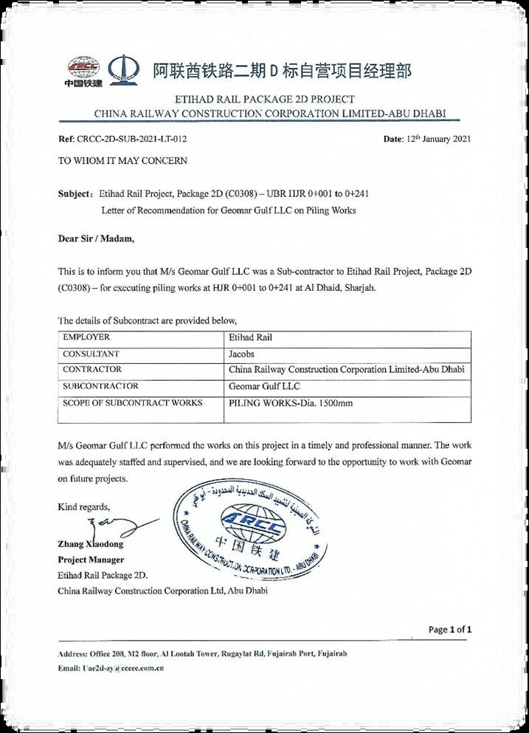
REGISTRATION & CERTIFICATION
Major Approvals And Letters Of Appreciations

