Slide 1


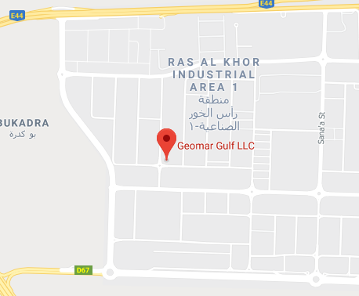
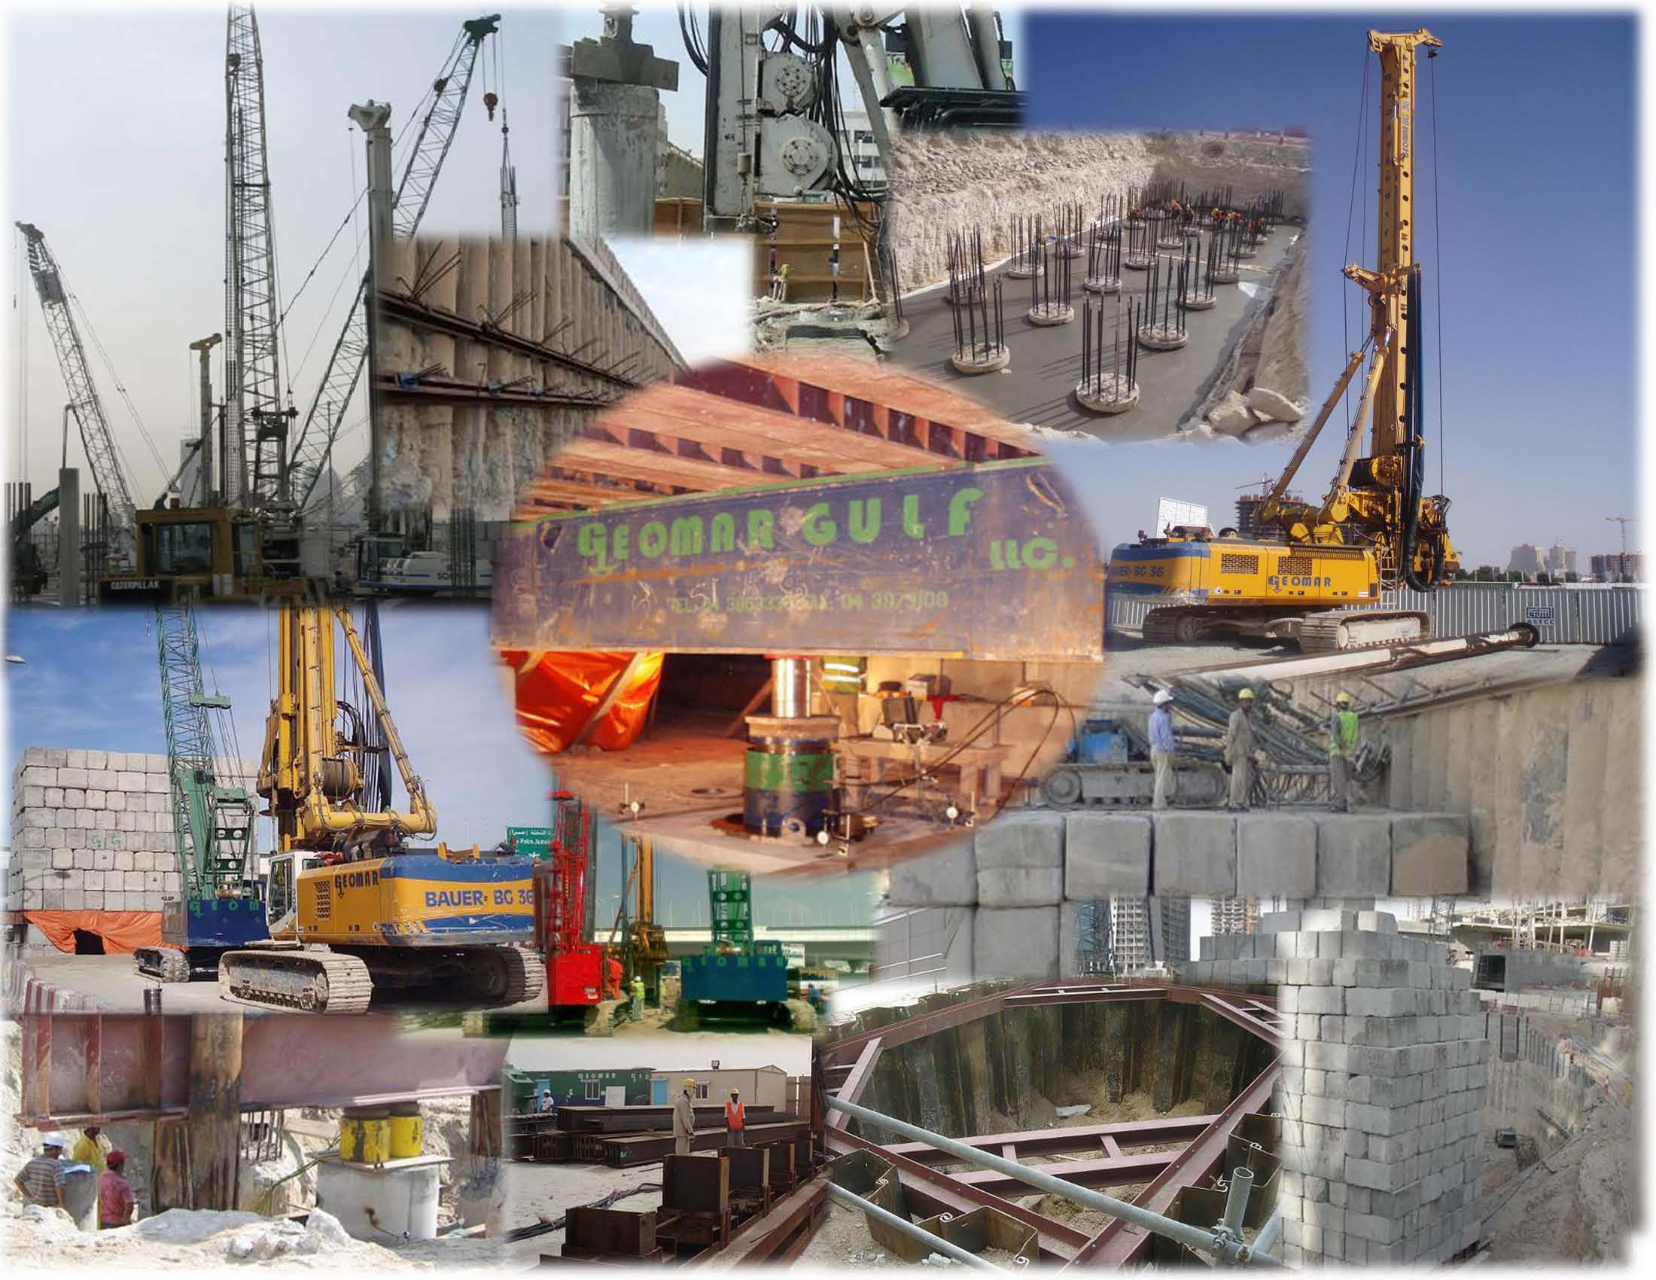
COMPANY PROFILE
2022
CONTACT US
GEOMAR GULF LLC
PO Box 122801
Dubai UAE
Tel: 04 320 98 97
Fax:04 320 9009
info@geomargulfllc.com
www.geomargulfllc.com
https://goo.gl/maps/QbPQQMsgks6Xr8Cj6

Slide 2
EXECUTIVE SUMMARY
Geomar Gulf LLC is based in UAE as a foundation specialist licenced for both design and construction of all kinds of onshore and offshore piling and shoring works.
Geomar Gulf LLC is a partnership between local Al Shafar Group of U.A.E and Geomar A.S. of Turkey that has been established in the U.A.E since 2004 and is capable of undertaking and designing in every aspect of the Infrastructure works in Geotechnical Field. We completed numerous number of projects in Oman, Turkmenistan, Iraq, Abu Dhabi and Dubai and as Geomar Gulf LLC we are ready to serve our professional services for offshore and onshore infrastructure in middle east and Africa region
The company is managed by a top management team that has over 30 years of experience working in Middle East and Russian countries, thus we possess an in-depth knowledge of the international market and extensive knowledge of the ground conditions.
Our vision is to offer our clients foundation solutions with optimum engineering and assist them with the value engineering of your projects.
Geomar Gulf LLC has the financial backing of the Al Shafar Group. Al Shafar Group was established in early 1960s and has made a significant contribution to the development of Dubai since the 60s. There are 24 companies under the umbrella of the Al Shafar Group.

Slide 3
INTRODUCTION AND BRIEF HISTORY
As Geomar Gulf LLC, during the past 18 years we are active and licenced in UAE ,and completed over 140 projects. Our services as geotechnical onshore and offshore contractor includes but not limited to design and execution of cast in situ bored piles from 200 mm to 3000 mm in diameter, ability to perform load tests up to 3000 tons, driven piles, soil improvement, jet grouting, sand pile, ground anchors, all kinds shoring (sheet piles, secant piles, soldier piles, etc), monitoring, dewatering and excavation works.
Geomar Gulf LLC has been involved in several projects in both design and execution stages since its foundation and took its place as one of the well-known piling companies in Dubai. Geomar AS of Turkey is a veteran in the field of geotechnical works and can extend resources to Geomar Gulf as needed. Geomar AS is one of the most active and well-known piling companies in Turkey and was founded by a team who has over 35 years of experience in the Geotechnical field.

Slide 4
GEOMAR GULF VISION
Geomar Gulf LLC aims to achieve a highly acclaimed status as a Foundation Specialist Contractor known for its promising capabilities by consistently improving and delivering exceptional ground engineering solutions and breaking new grounds with newest technologies that is sustainable, quality assured and economical via value engineering.
GEOMAR GULF MISSION
Geomar Gulf LLC’s goal is to ensure that all projects are accomplished in the best quality of professionalism by providing highly trained engineers and labours that reflects the company’s name and status. We aim to create more and maintain long term relationships between our clients that is based on trust, mutual benefit, flexibility and respect. The following factors help us achieve success;
Excellent workmanship, teamwork and efficiency
Developing and retaining business relations with potential and existing clients
Firm on-site management
Value engineered project estimation
GEOMAR GULF POLICY
Geomar Gulf LLC is committed to deliver high quality services that conform to all relevant ISO Standards. We ensure that all personnel fully understands and comply with all company policy such as Health & Safety Policy, Environmental Policy and Company Quality Systems.

Slide 5
ABOUT US
Geomar Gulf has the capability to undertake large projects as we have the expertise, experience, full range of powerful machineries and equipment as well as a strong financial backing of the Al Shafar Group.
Over the years, Geomar Gulf has developed extensively. Our areas of capability for onshore and offshore projects are listed but are not limited to the following:
• Instrumentation, monitoring and testing
• Shoring Systems
  o Shoring with soldier steel profiles
  o Diaphragm Wall
  o Shoring system with secant piles
  o Shoring with sheet piles
  o Shoring system with contiguous piles
• Pile Foundations
  o Bored cast in situ piles
  o All kinds of Driven piles
  o Continuous flight auger (CFA) piles
  o Cast in situ driven piles
• Macro piling
• Soil Improvement
Jet grout
• Ground Anchors
  o Permanent
  o Temporary

Slide 6
ORGANIZATION CHART
IDRIS DEMIRCIOGLU
MANAGING PARTNER
BERK OGUNC TECHNICAL MANAGER
DESIGN ENGINEER
ACCOUNTS/HRM
ACCOUNTS
PROJECT MANAGER
SITE MANAGER
MECHANICAL / SAFETY ENGINEERS
SURVEYOR
FOREMAN
RIGGERS
RIG/CRANE OPERATORS
LABORS
WELDERS
AHMED ALI AL SHAFAR
PARTNER
BARIS DEMIRCIOGLU
DEPUTY GENERAL MANAGER
MECHANIC
ELECTRICIAN

Slide 7
EXPERIENCE IN OIL & GAS SECTOR
Geomar Gulf LLC has personnel that completed several piling and shoring works in Oil and Gas Sector in UAE, Kazakhstan, Saudi Arabia, Turkey and Azerbaijan.
Project Name | Year | Client | Activity | Location
Tengiz Oil Plant debottlenecking project | 1997-1999 | Tengiz Chevroil | 220cm mini piling works | Kazakhstan
Tengiz Oil Plant expansion project (TRAIN 5) | 1998-2001 | Tengiz Chevroil | 30x30cm precast pile driving | Kazakhstan
Tengiz Oil Plant Tank Farm | 1999-2000 | Tengiz Chevroil | Sheet Pile driving for cofferdams | Kazakhstan
Gizan Plant | 2002 | ARENCO | Piling Works | Saudi Arabia
Second Generation Project & Sour Gas Injection Project | 2003-2005 | Tengiz Chevroil | Precast pile driving & Sheet Pile driving for cofferdams | Kazakhstan
C&WP Topside Project | 2003 | BP | 600mm stone columns | Azerbaijan
Izmir Aliaga Natural Gas Combined Cycle Power Plant | 2000 | Bechtel-Enka | 600mm jet-grout columns | Turkey
Desulphurization Plant | 2010-2011 | Hyundai | 600mm bored piles | Turkmenistan
Ras Al Khaimah Gas Plant | 2009 | Rak Gas Authority | Shoring works with contiguous piles | RAK, UAE
Replacement of Underground Fuel Storage Tanks | 2013 | Wade Adams | Shoring works with sheet piles with strut | Sharjah, UAE

Slide 8
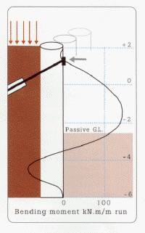
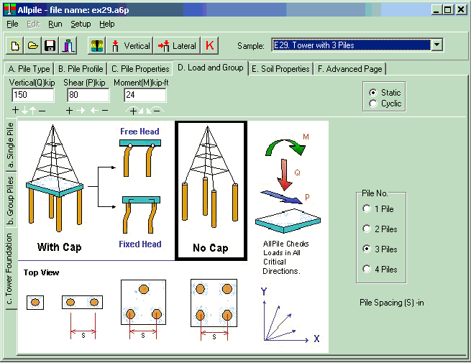
DESIGN TECHNOLOGY
Geosolve Wallap
WALLAP is a powerful, fast and user-friendly program for analysing the stability of cantilevered and propped retaining walls. WALLAP is suitable for the analysis of both temporary works, such as sheet pile walls, and permanent works such as reinforced concrete diaphragm walls and contiguous bored pile walls.
Civiltech Allpile
AllPile is a Windows-based analysis program that handles virtually all types of piles, including steel pipes, H-piles, pre-cast concrete piles, auger-cast piles, drilled shafts, timber piles, jetted piles, tapered piles, piers with bell, micropiles (minipiles), uplift anchors, uplift plate, and shallow foundations.

Slide 9
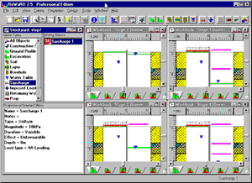
DESIGN TECHNOLOGY
Geocentrix ReWaRD
ReWaRD is one of the leading programs for the design of embedded retaining walls, incorporating several UK and international design standards including BS 8002 and Eurocode 7. Designed by engineers for engineers, ReWaRD draws upon the technical expertise of Geocentrix to produce the most powerful and user friendly set of tools for retaining wall design.
Autodesk Autocad
AutoCAD® design and documentation software, one of the world’s leading 2D and 3D CAD tools. Speed documentation, share ideas seamlessly, and explore ideas more intuitively in 3D. With thousands of available add-ons, AutoCAD software provides the ultimate in flexibility, customized for specific needs.

Slide 10
KEY PERSONNEL CV

Slide 11
KEY PERSONNEL CV

Slide 12
KEY PERSONNEL CV

Slide 13
EQUIPMENT LIST

Slide 14
PLANTS AND MACHINERIES
DRILLING RIGS
Bauer BG36
Soilmec SR100

Slide 15
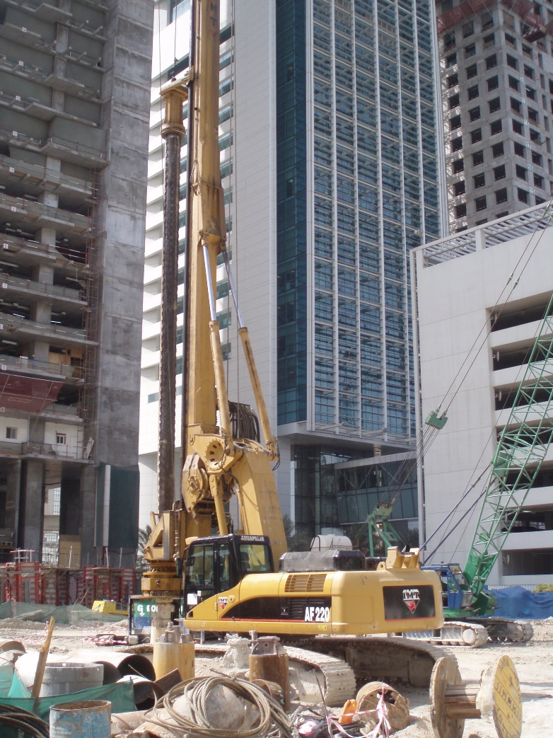
PLANTS AND MACHINERIES
DRILLING RIGS
IMT AF220
Soilmec R825

Slide 16
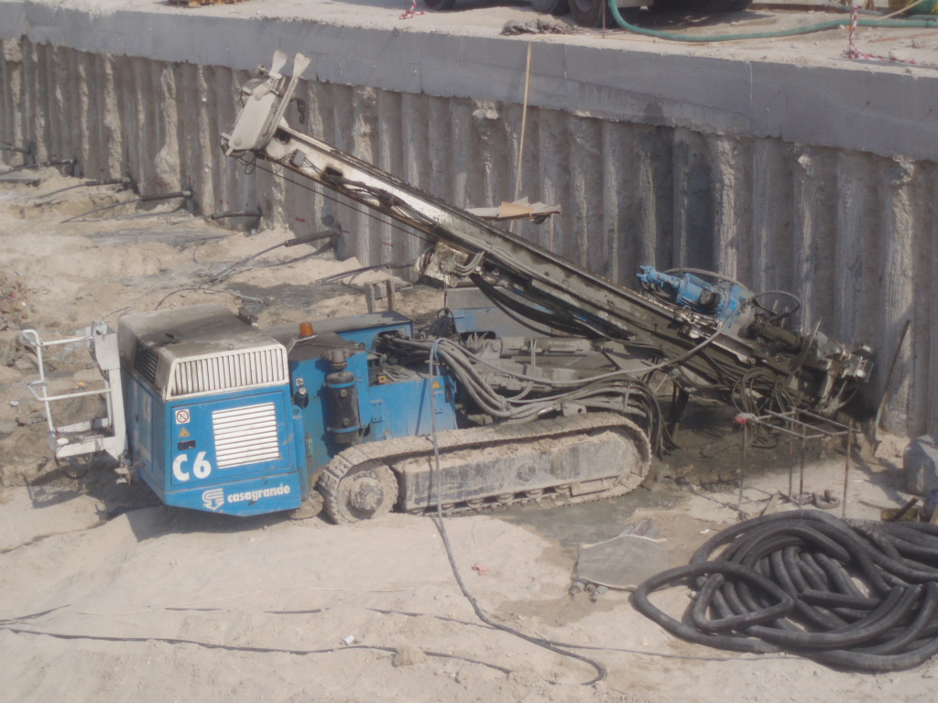
PLANTS AND MACHINERIES
DRILLING RIGS
Soilmec R620 (2 No)
Casagrande C6

Slide 17
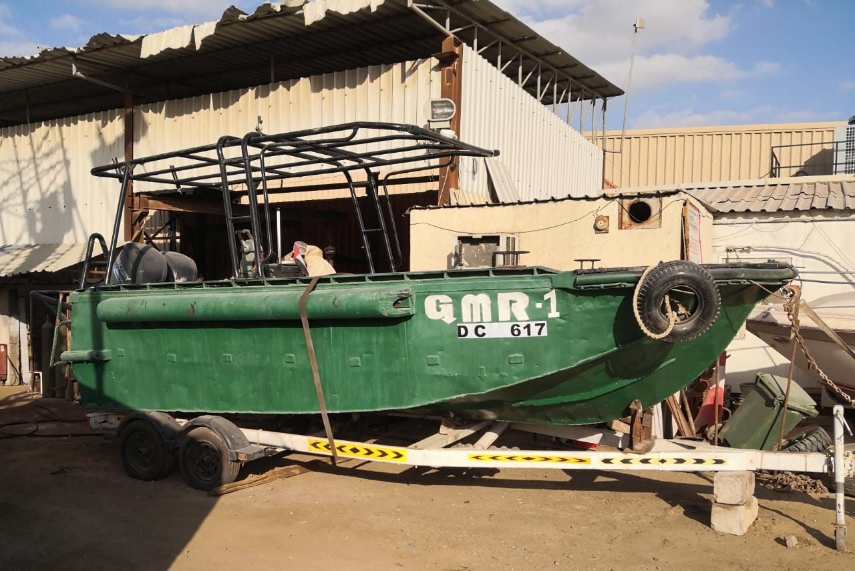
PLANTS AND MACHINERIES
MODULAR BARGE AND TUG BOAT
Area: 27m*12m

Slide 18
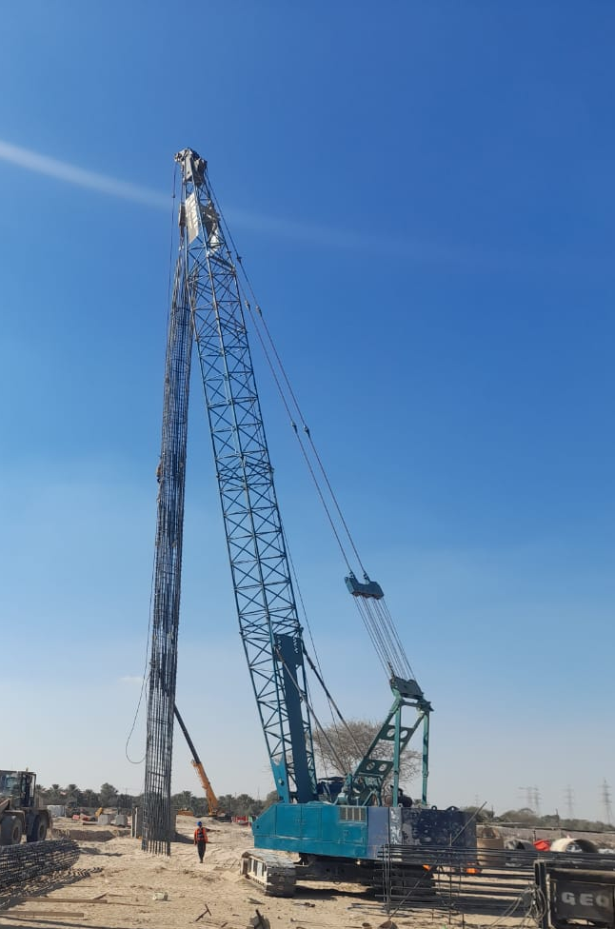
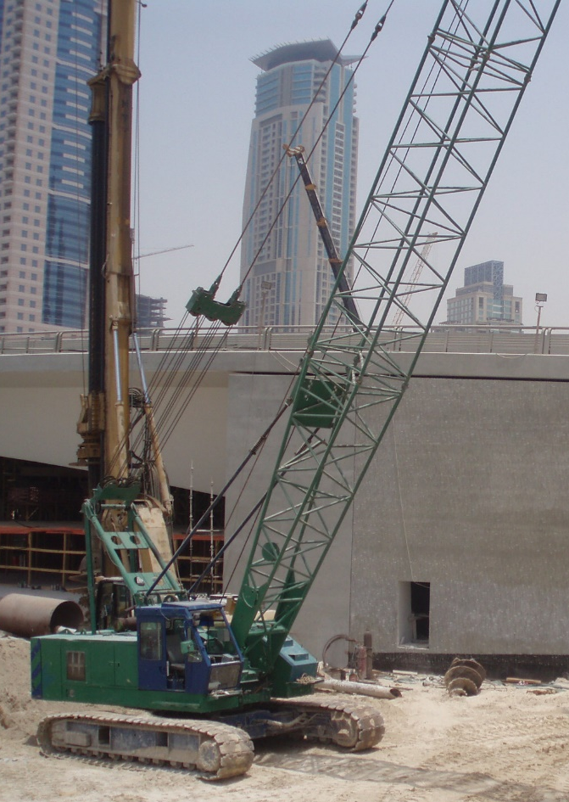
PLANTS AND MACHINERIES
CRAWLER CRANES
Sany SC500D
NCK Raiper
Samsung Hitachi CX500
(2 No)
RBC H40

Slide 19
PLANTS AND MACHINERIES
HAMMERS
PTC 50HD2L
Vibro-Hammer
PTC 30H1 Vibro-Hammer (2 NO)
Starke HD30
Diesel-Hammer
Delmac D46 - 32
Diesel-Hammer

Slide 20
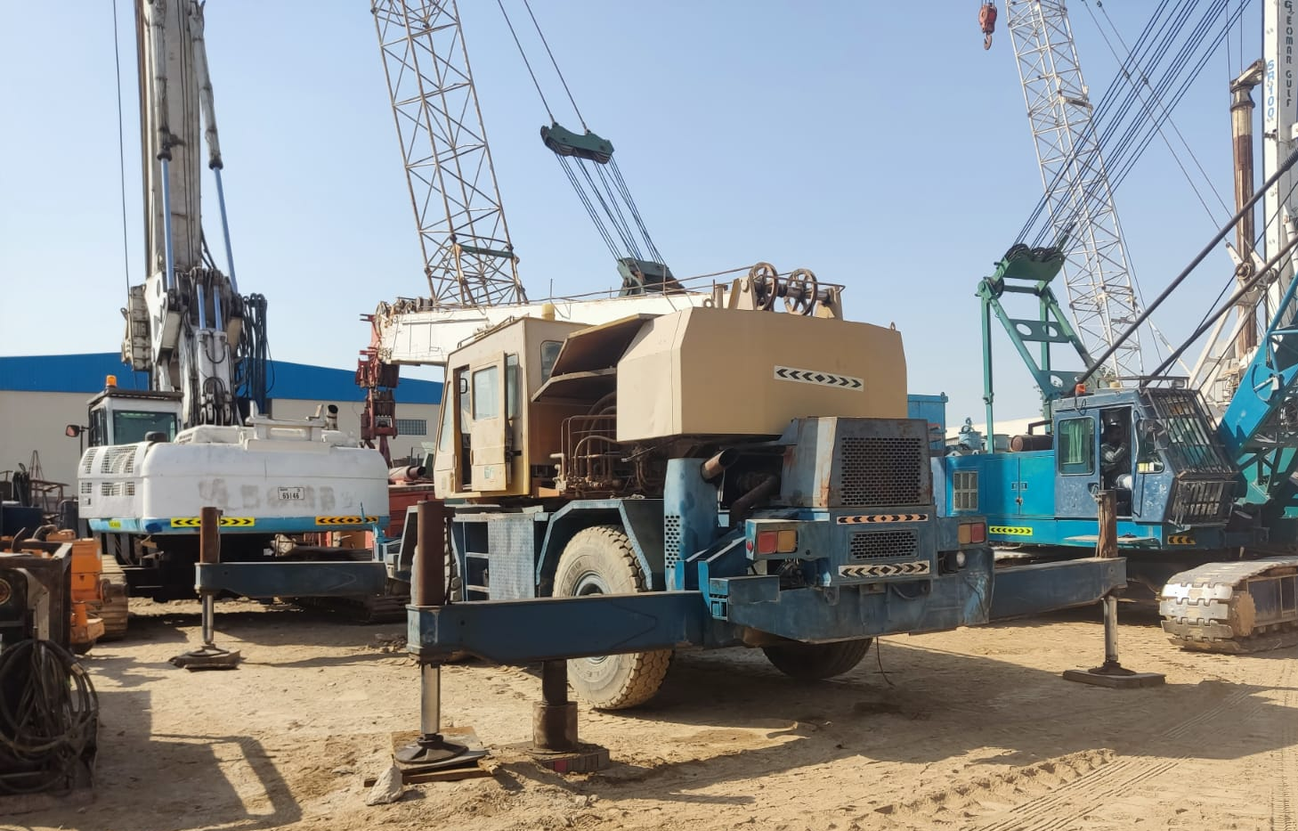
PLANTS AND MACHINERIES
MOBILE CRANES
Tadano GR-300EX
Hyundai HC50

Slide 21
COMPLETED PROJECTS
2004 - 2022

Slide 22
ONSHORE PROJECTS

Slide 23
ONSHORE PROJECTS

Slide 24
ONSHORE PROJECTS

Slide 25
ONSHORE PROJECTS
In addition to above projects, Geomar Gulf LLC completed more than 30 numbers of private minor projects.

Slide 26
OFFSHORE PROJECTS

Slide 27
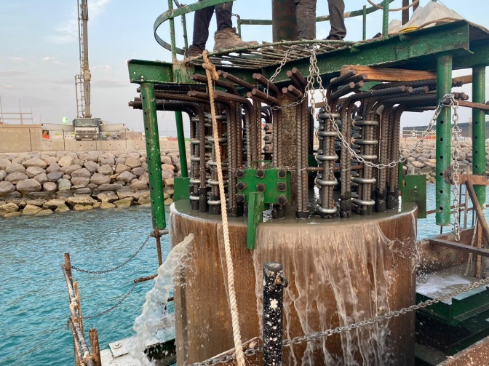
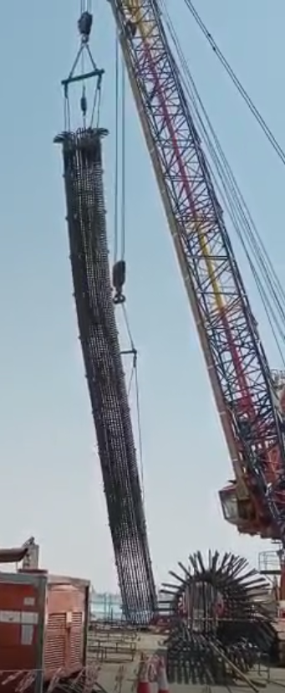
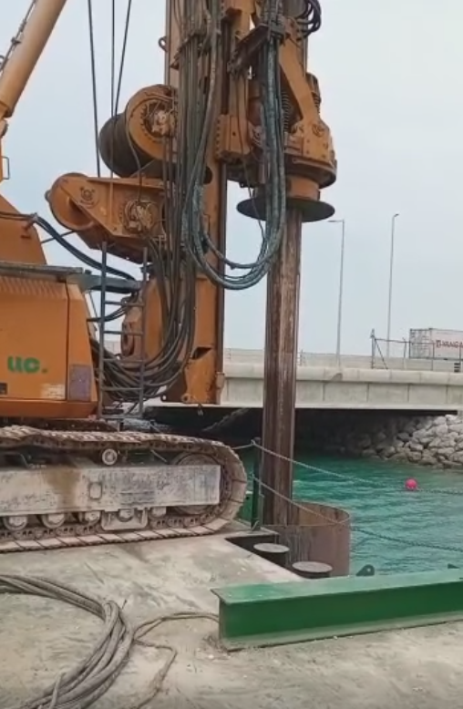
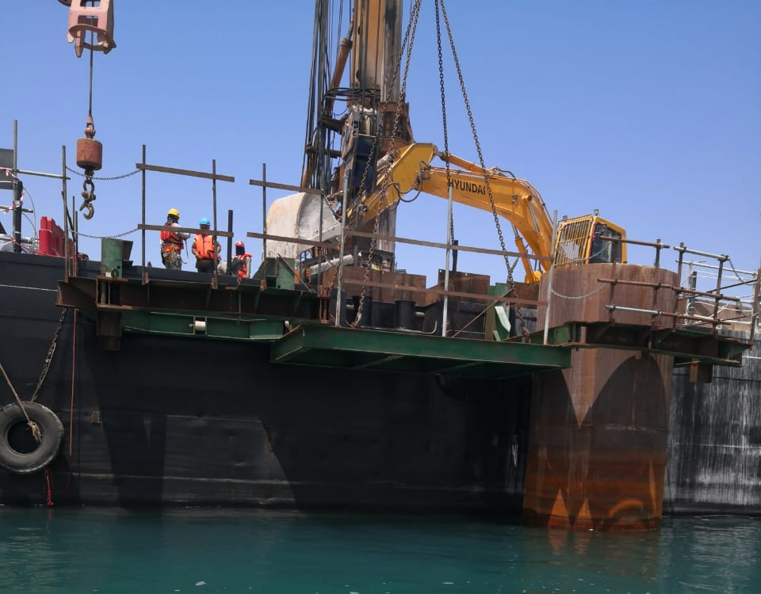
PICTURES OF MARINE PROJECTS
M51 – ETIHAD RAIL STAGE 2&3 PROJECT D0203 PACKAGE 2F2 KHALIFA BRIDGE

Slide 28
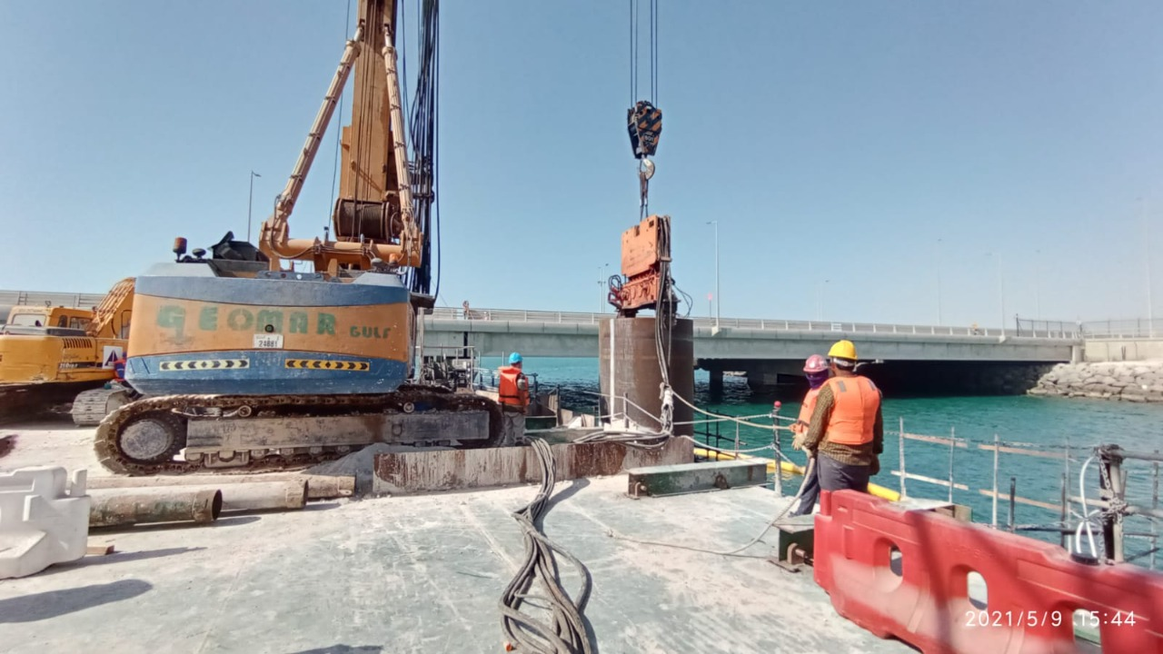
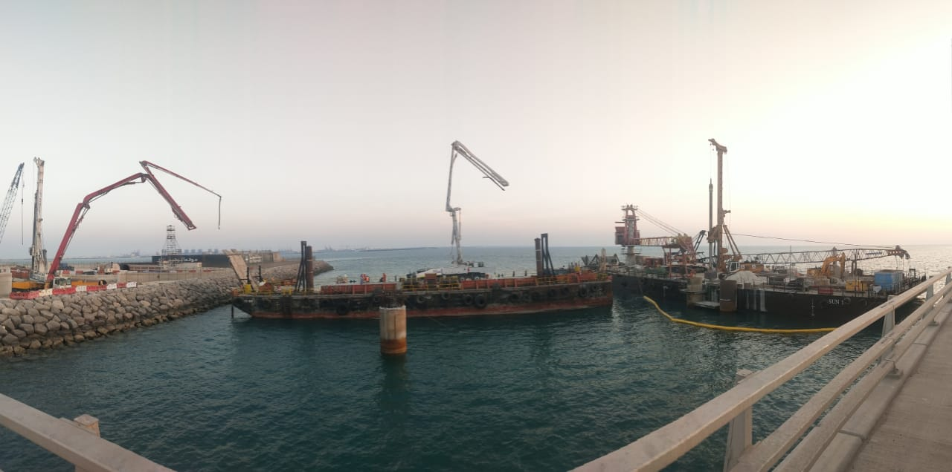
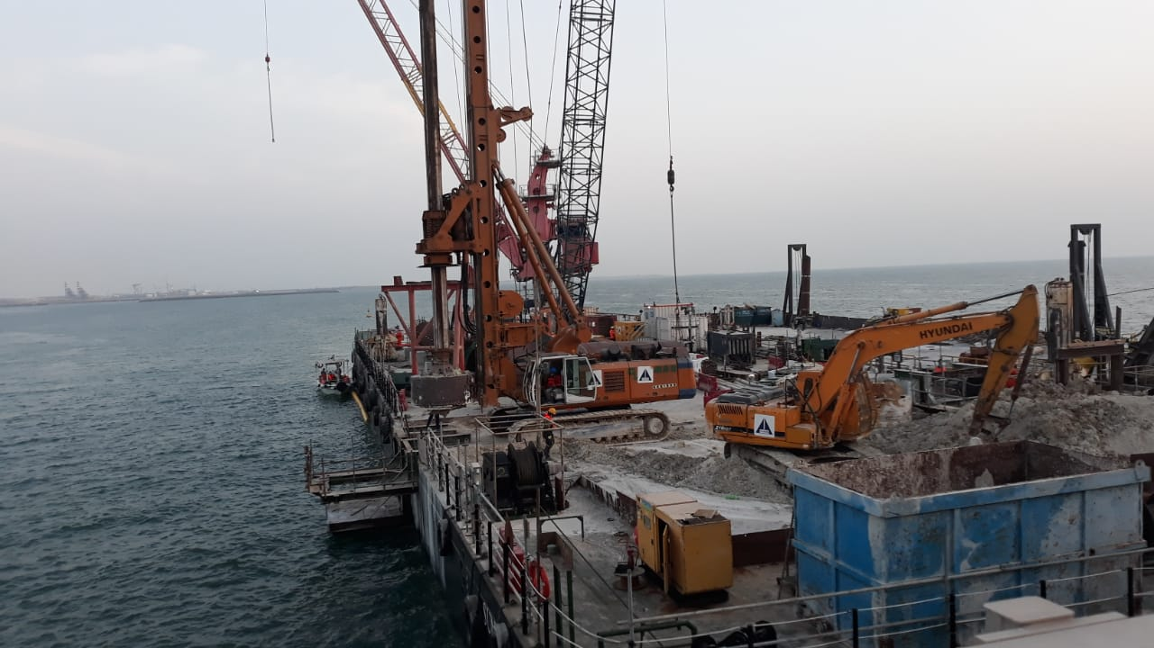
PICTURES OF MARINE PROJECTS
M51 – ETIHAD RAIL STAGE 2&3 PROJECT D0203 PACKAGE 2F2 KHALIFA BRIDGE

Slide 29
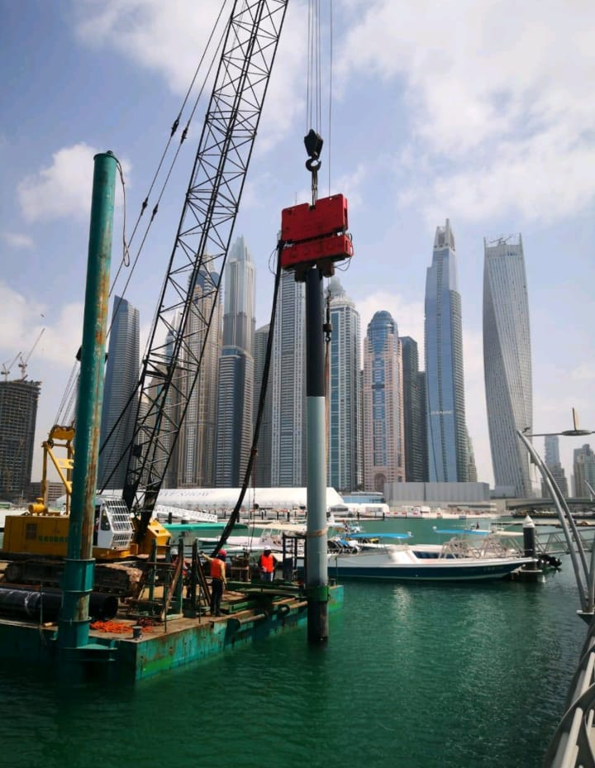
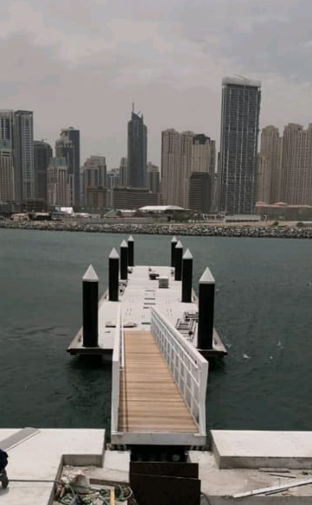
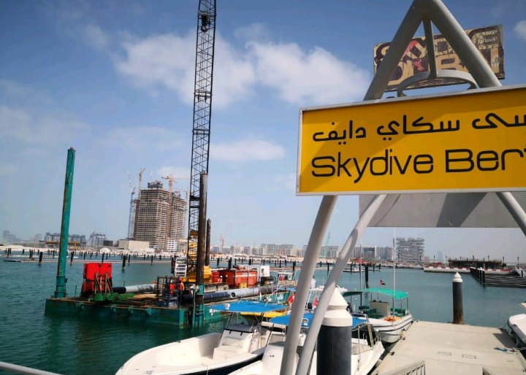
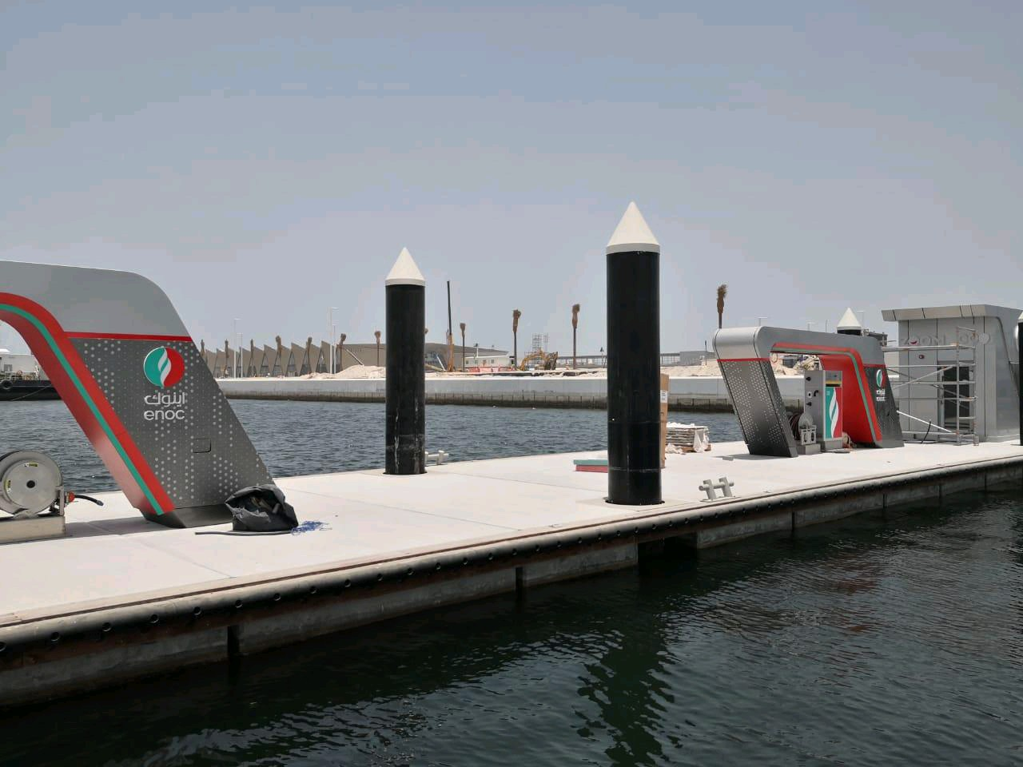
PICTURES OF MARINE PROJECTS
M47 – DESIGN & CONSTRUCTION OF HARBOUR MARINA

Slide 30
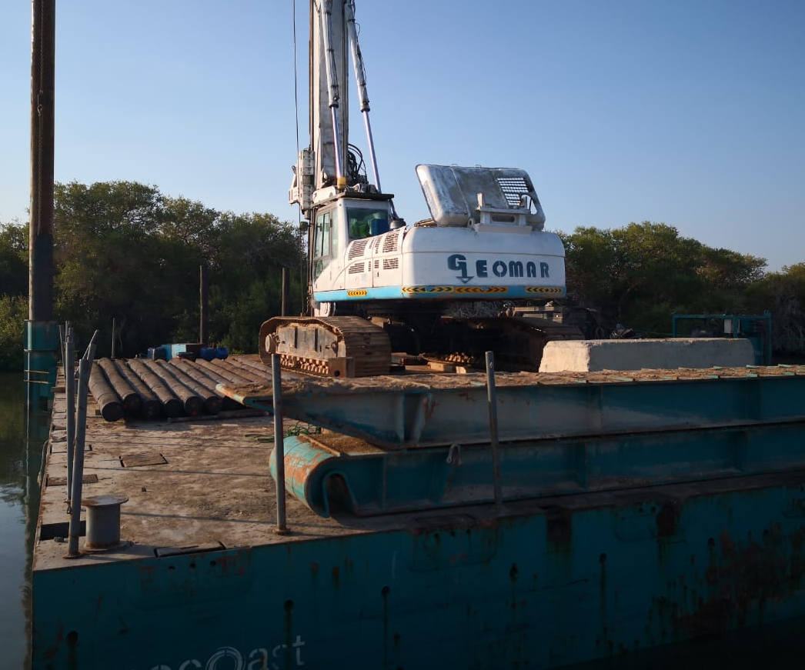
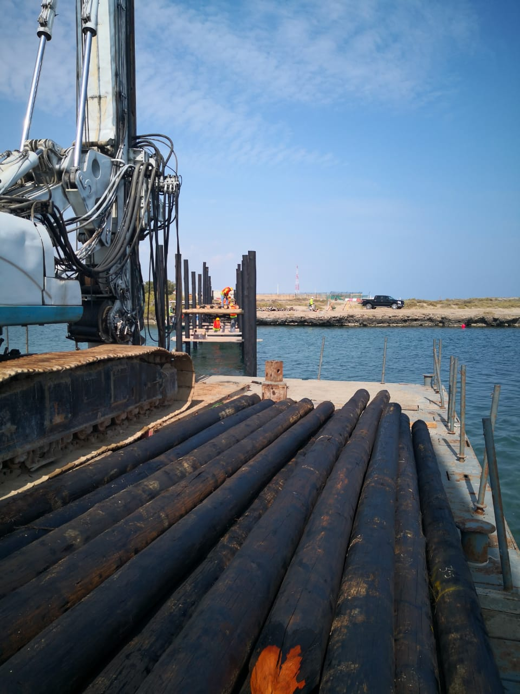
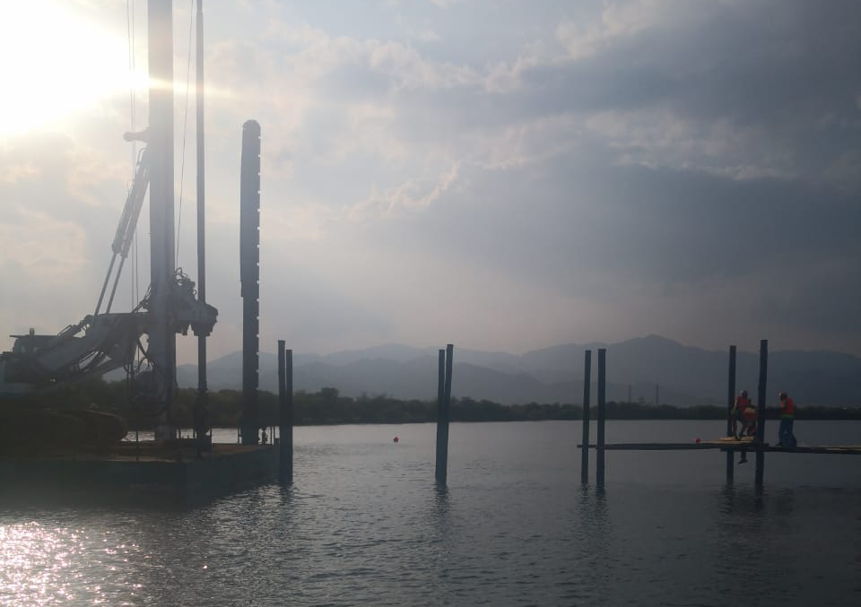
PICTURES OF MARINE PROJECTS
M46 - DRILLING WORKS FOR CONSTRUCTION OF MANGROVE BRIDGE

Slide 31
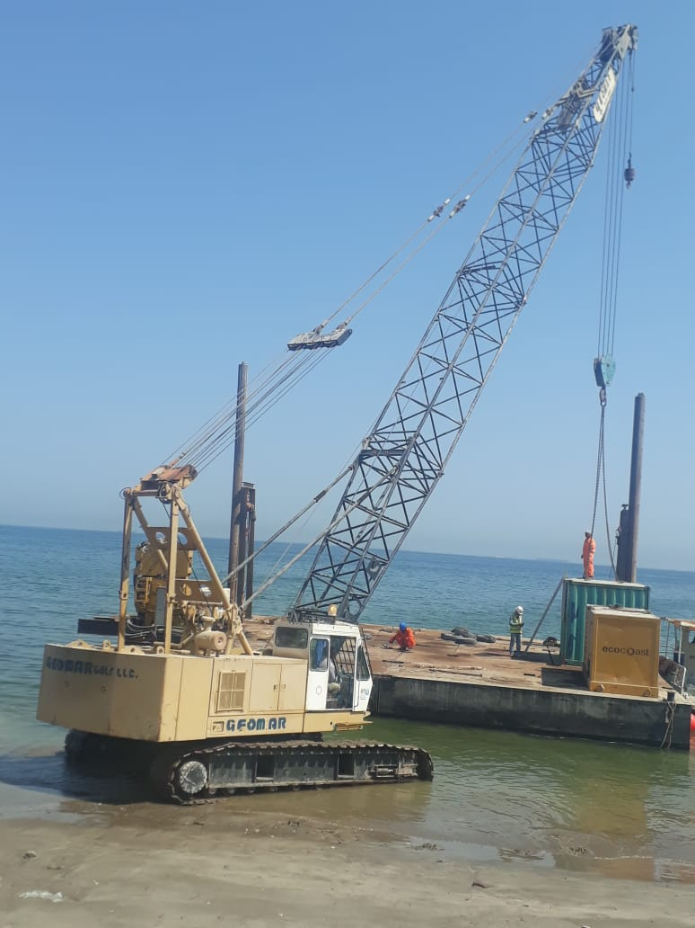
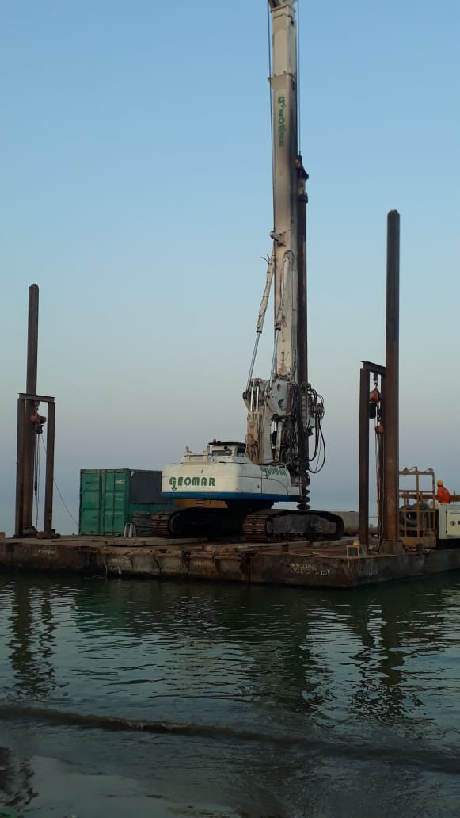
PICTURES OF MARINE PROJECTS
M40-Squadron – Mirbah Pontoon Deployment

Slide 32
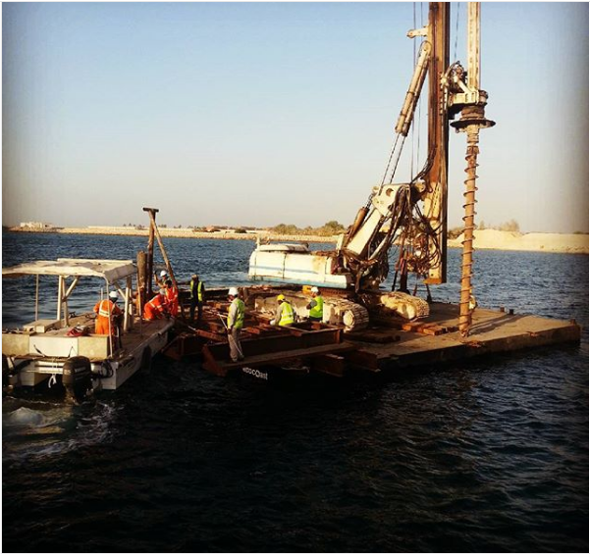
PICTURES OF MARINE PROJECTS
M30 – CICPA Ghantoot

Slide 33
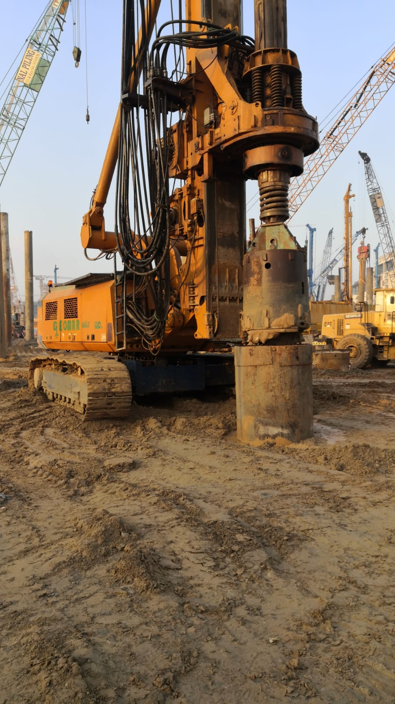
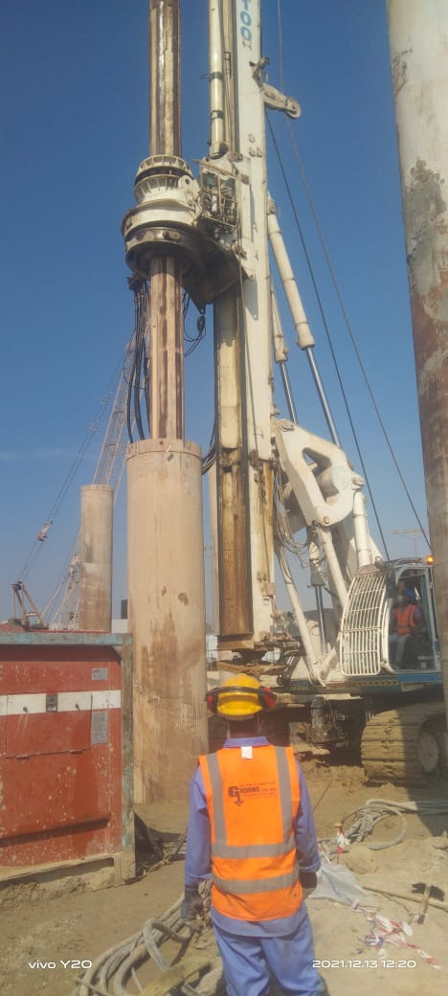
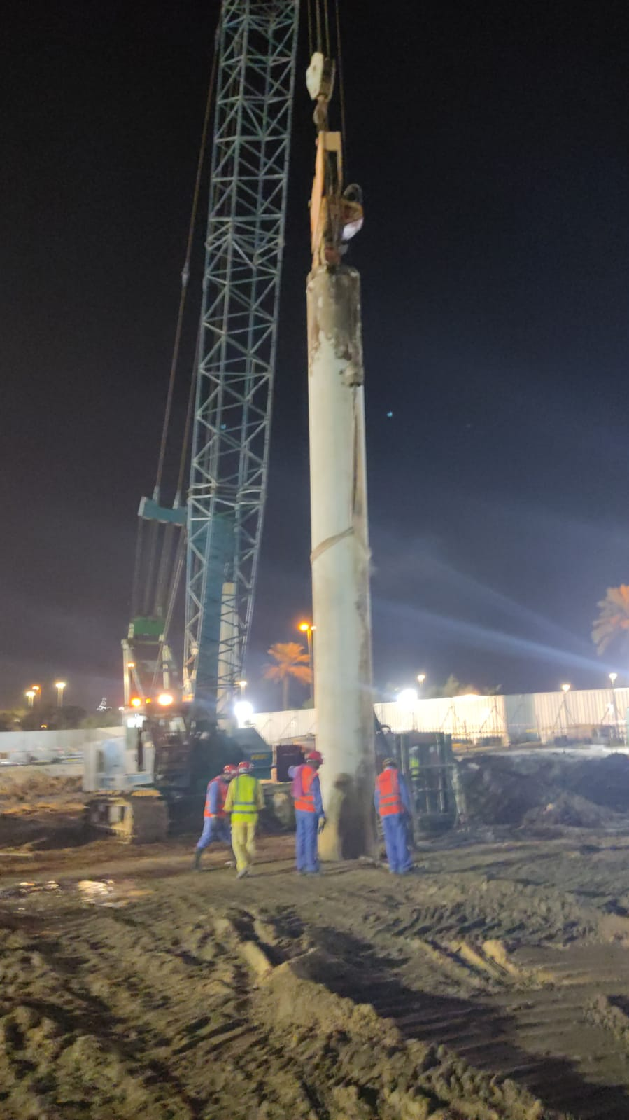
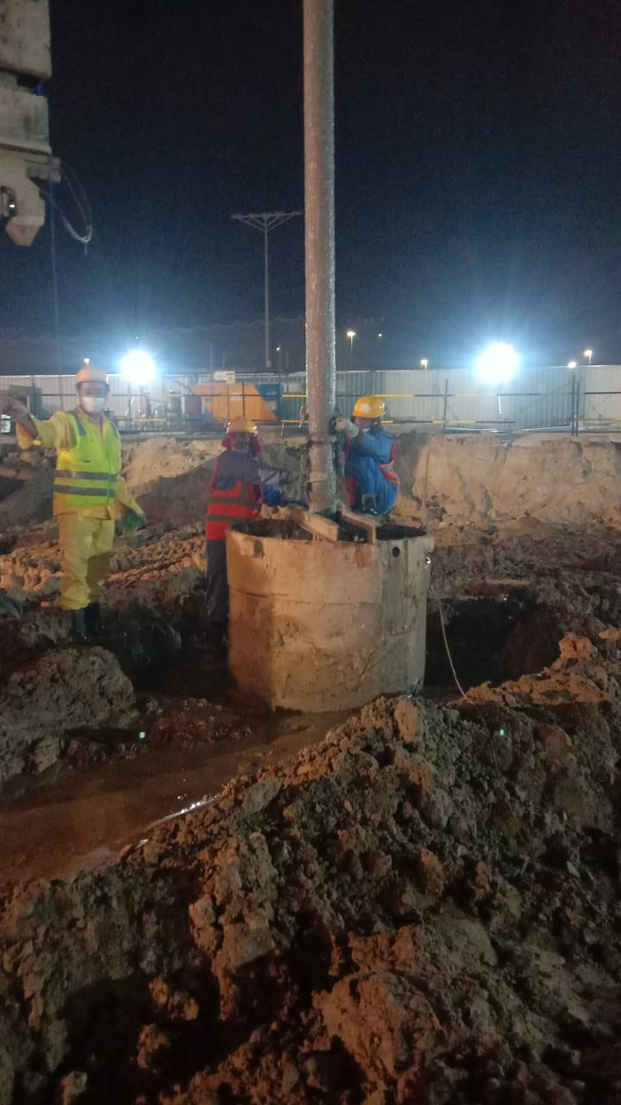
PICTURES OF PROJECTS IN UAE
G122 SOBHA HARTLAND PROPOSED B+G+5P+41+R

Slide 34
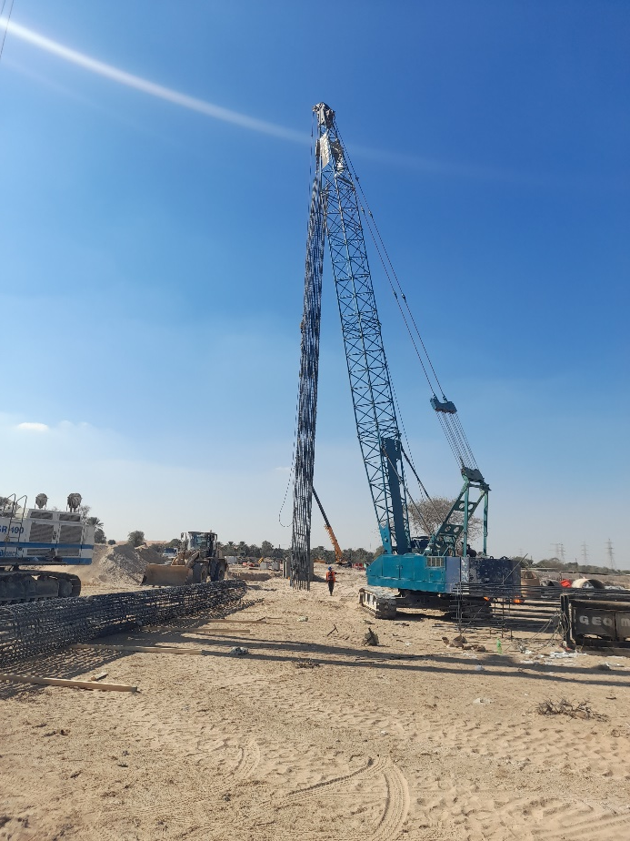
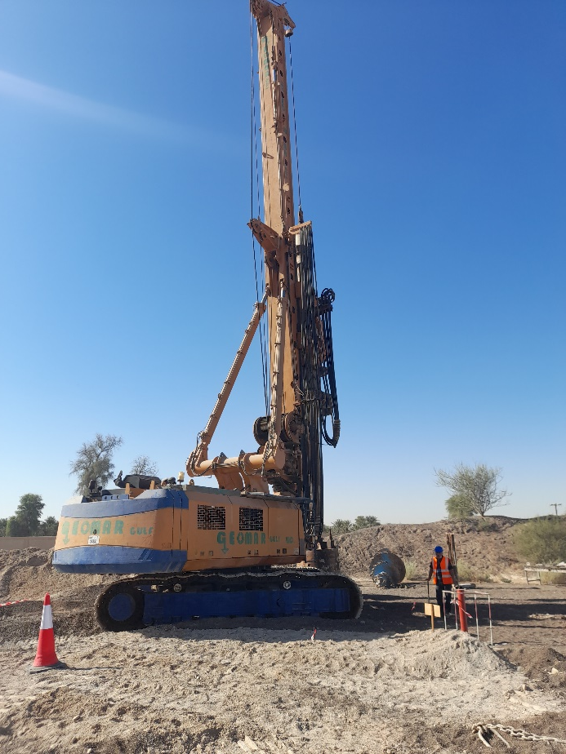
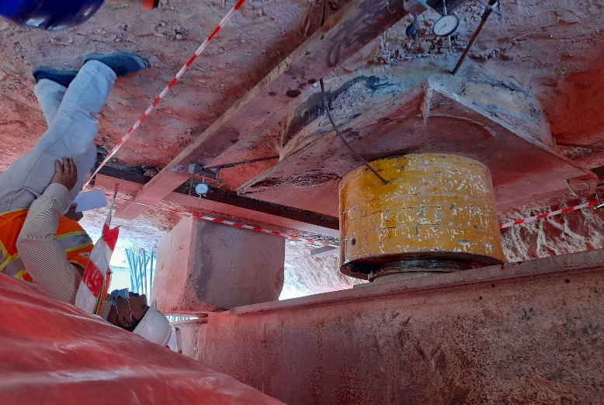
PICTURES OF PROJECTS IN UAE
G121 Etihad Rail 2D – Sharjah to Fujairah

Slide 35
PICTURES OF PROJECTS IN UAE
G118 Contract R1048-1/1A/2/5, R1005-2: Improvement of Expo2020 Roads Network (5 different packages)

Slide 36
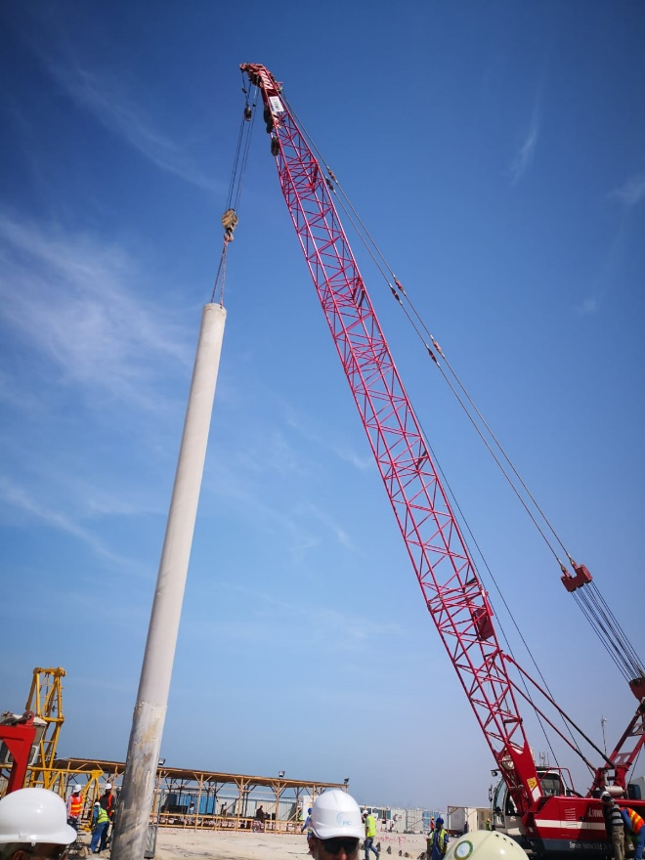
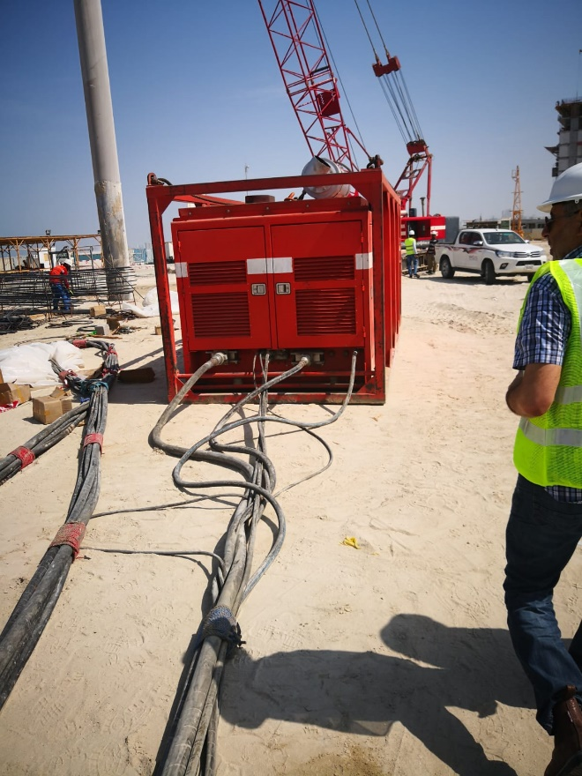
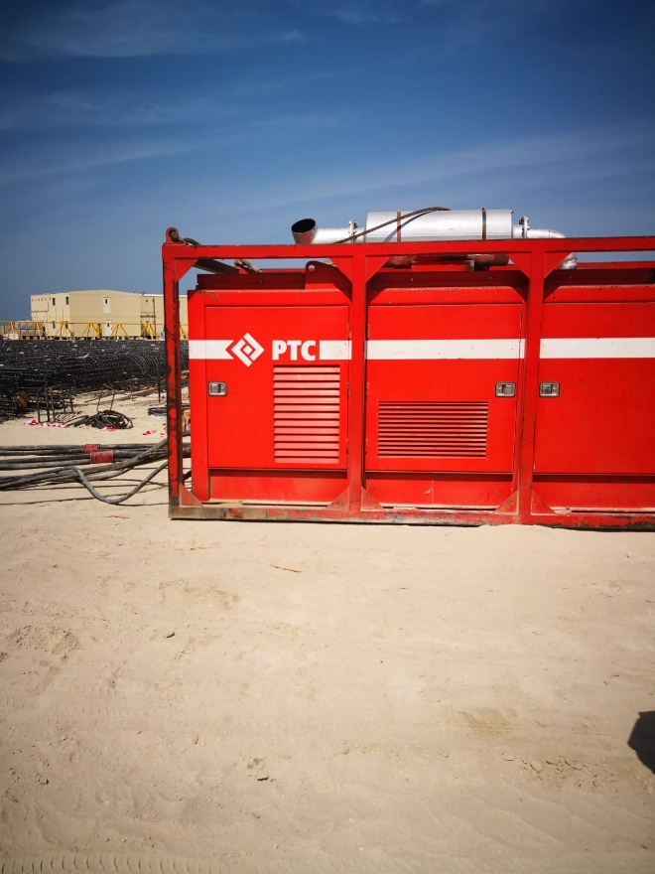
PICTURES OF PROJECTS IN UAE
G106 P506 - 2B+G+1+2 Roof Commercial Building (P462) on Plot No. 4237986)

Slide 37
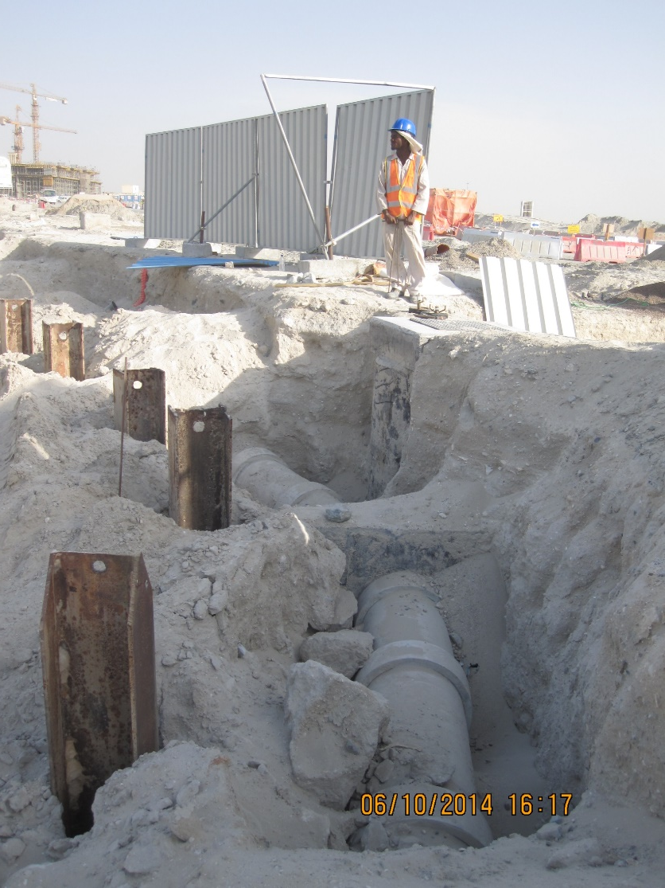
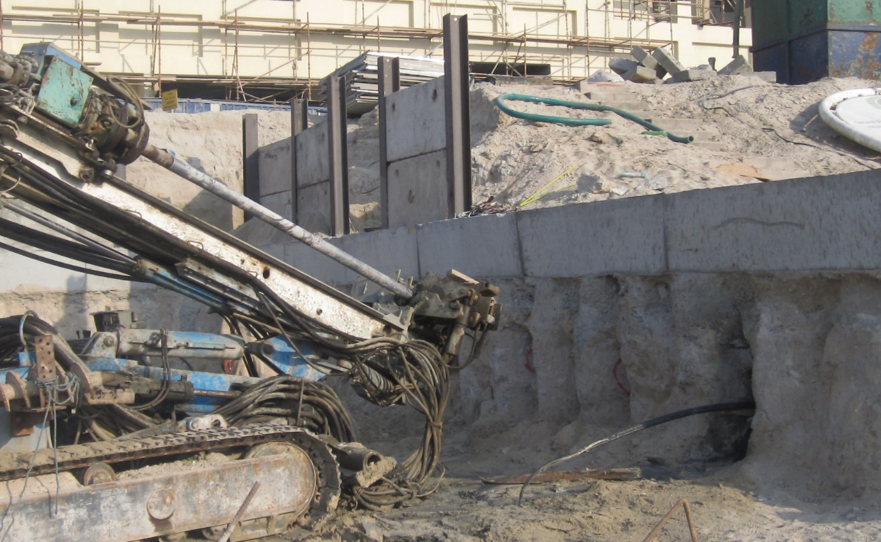
PICTURES OF PROJECTS IN UAE
G89(Proposed 2B+LG+G+9)

Slide 38
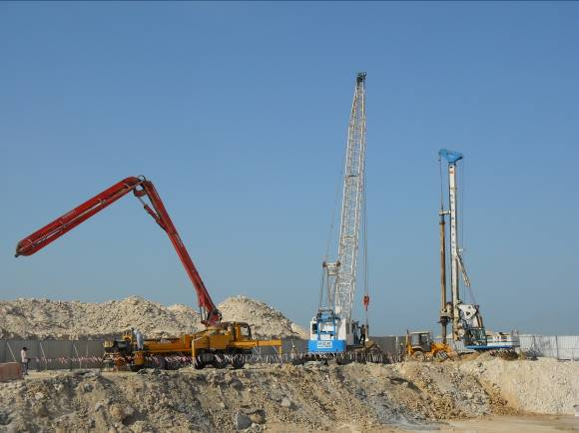
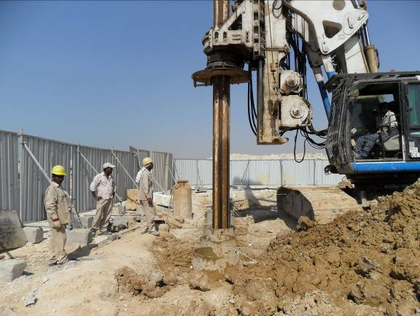
PICTURES OF PROJECTS IN UAE
  (G69) SUHAIL TOWER - WATERFRONT/ 20

Slide 39
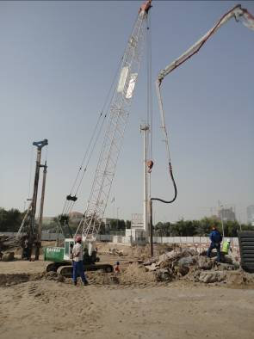
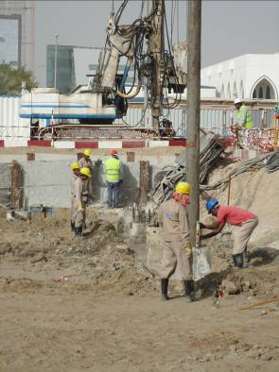
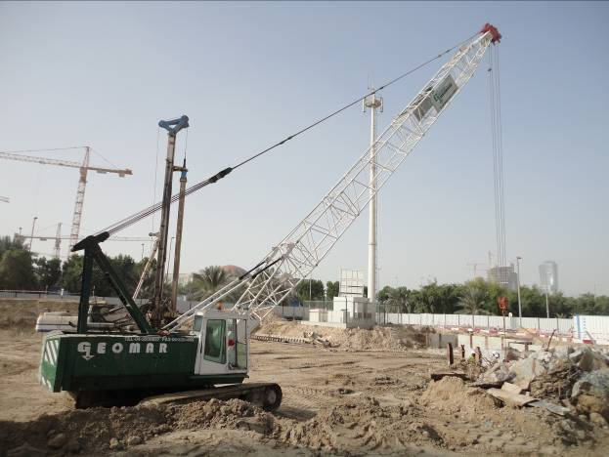
PICTURES OF PROJECTS IN UAE
  (G68) POLICE STATION & BARRACKS / ABU DHABI / 2010

Slide 40
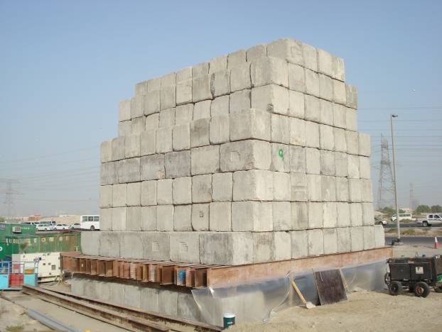
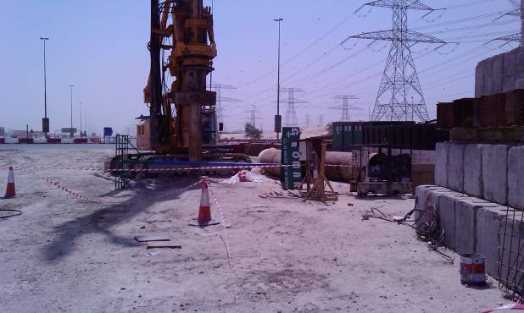
PICTURES OF PROJECTS IN UAE
  (G62) IMPROVEMENT OF AL KHAIL ROAD BRIDGESTRUCTURE / 2009

Slide 41
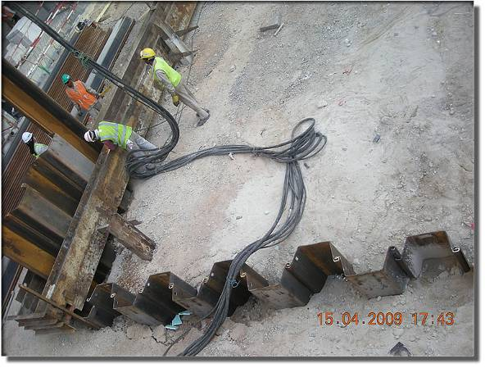
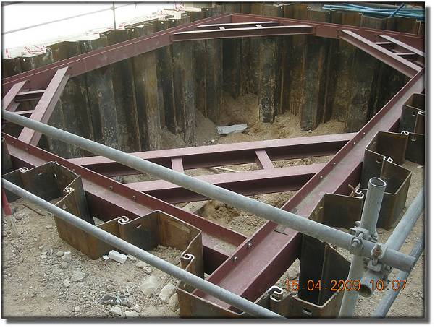
PICTURES OF PROJECTS IN UAE
  (G58) LIMITLESS DOWNTOWN JEBEL ALI PROJECT/ 2009 Sheet Piling

Slide 42
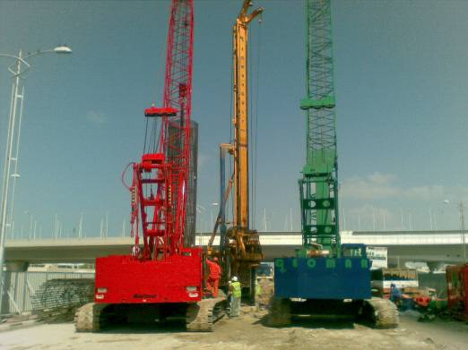

PICTURES OF PROJECTS IN UAE
  (G57) PALM JUMEIRAH GATEWAY TOWERS FLYOVER ACCESS/ 2009 - Piling

Slide 43


PICTURES OF PROJECTS IN UAE
  (G55) IMPROVEMENT OF EMIRATES ROAD BRIDGE STRUCTURES/ 2008

Slide 44


PICTURES OF PROJECTS IN UAE
(G53) VERDE RESIDENCE- DUBAI MARYTIME CITY/2008

Slide 45





PICTURES OF PROJECTS IN UAE
  G39(MIRDIFF OFFICE BLOCK (3B+GR+F) / 2010 Second Row Anchors

Slide 46


PICTURES OF PROJECTS IN UAE
(G36) 2B+G+16 BUILDING- TECOM/2008

Slide 47


PICTURES OF PROJECTS IN UAE
(G33) PROMENADE BRIDGE LINKS (L1 &L2) /AL SAFOOH/ 2008

Slide 48


PICTURES OF PROJECTS IN UAE
(G33) PROMENADE BRIDGE LINKS (L1 &L2) /AL SAFOOH/ 2008

Slide 49


PICTURES OF PROJECTS IN UAE
(G27) - 3B+G+M+3 ARY COMMERCIAL BUILDING / KARAMA / 2007

Slide 50


PICTURES OF PROJECTS IN UAE
(G24) - RAKEN BRIDGE WIMPY INTERCHANGE / 2006

Slide 51


PICTURES OF PROJECTS IN UAE
(G18) - 2B+G+6 COMMERCIAL & OFFICE BUILDING / DIC / 2006 –Shoring

Slide 52



PICTURES OF PROJECTS IN UAE
G16) - 4B+G+44 COMMERCIAL & OFFICE BUILDING / JLT / 2007 – Piling

Slide 53


PICTURES OF PROJECTS IN UAE
(G8) - LONDON CROWN 3 PROJECT / MANKHOOL / 2006

Slide 54


PICTURES OF PROJECTS IN OMAN
  (G60) MUSCAT OASIS PHASE IV/ MUSCAT / 2009

Slide 55



PICTURES OF PROJECTS IN OMAN
  (G60) MUSCAT OASIS PHASE IV/ MUSCAT / 2009

Slide 56


PICTURES OF PROJECTS IN OMAN
  MUSCAT OASIS PHASE IV PROJECT OMAN / 2009

Slide 57


PICTURES OF PROJECTS IN OMAN
  (G79) DUALIZATION OF BIDBID SUR PROJECT – PHASE 1

Slide 58


PICTURES OF PROJECTS IN OMAN
  (G79) DUALIZATION OF BIDBID SUR PROJECT – PHASE 1

Slide 59


PICTURES OF PROJECTS IN OMAN
  (G79) DUALIZATION OF BIDBID SUR PROJECT – PHASE 1

Slide 60





PICTURES OF PROJECTS IN IRAQ
  G82 WQ – 2 EARLY OIL PRODUCTION GAS TURBINE POWER PLANT

Slide 61

APPROVALS & REFERENCES
  ROAD AND TRANSPORT AUTHORITY

Slide 62





APPROVALS & REFERENCES
  ROAD AND TRANSPORT AUTHORITY

Slide 63





APPROVALS & REFERENCES
  ROAD AND TRANSPORT AUTHORITY

Slide 64

APPROVALS & REFERENCES
  DUBAI ELECTRICITY & WATER AUTHORITY

Slide 65



APPROVALS & REFERENCES
  CONSULTANTS & CONTRACTORS

Slide 66




APPROVALS & REFERENCES
  CONSULTANTS & CONTRACTORS

Slide 67







APPROVALS & REFERENCES
  CONSULTANTS & CONTRACTORS

Slide 68



APPROVALS & REFERENCES
  CONSULTANTS & CONTRACTORS

Slide 69




APPROVALS & REFERENCES
  CONSULTANTS & CONTRACTORS

Slide 70




APPROVALS & REFERENCES
  CONSULTANTS & CONTRACTORS

Slide 71




APPROVALS & REFERENCES
  CONSULTANTS & CONTRACTORS

Slide 72

HEALTH, SAFETY & ENVIRONMENT
Geomar Gulf Health and Safety Plan identify and encompass the working behaviors and safe working practices and mandatory for the project. All levels of management from General Manager to Site Supervisor have a responsibility to ensure that those people working under their control are not exposed to unnecessary risk whilst they are at work.
The duty of care extends beyond what is legally required and covers the moral responsibility that all persons have to ensure others are not harmed by their acts or omissions.
To comply with its legal and moral responsibilities has the following objectives;
• Promote and maintain a safe and healthy working environment
• Provide suitable training, instruction, information
• Implement management system in compliance with the international practices and standards to support continual improvement
• Review operations and implement any necessary pre-caution
This Policy is written to assist Geomar Gulf LLC employees, consultants, vendors and other involved parties to play their part in maintaining the highest possible standards of safe working.
Geomar Gulf General Manager has the overall responsibility to manage health & safety and oversee the full implementation of this requirement on behalf of the company.
Idris Demircioglu
Managing Partner
  HEALTH AND SAFETY POLICY STATEMENT

Slide 73
HEALTH, SAFETY & ENVIRONMENT
Leadership and Accountability
Geomar Gulf management team will visibly demonstrate their commitment to safety, health and welfare of all stakeholders in the project and will achieve the highest attainable standard. Every manager/director will instruct their staff in any delegated duties or responsibilities they may be given to fulfill the company’s health and safety arrangements and will ensure adequate resources are made available to maintain these standards. The requirements of the Company’s Health and Safety Policies and Arrangements will be taken into account at the feasibility, planning design, procurement and construction stages of every project.
Incident Reporting
Any safety incident or accident occurring at site will be reported to Project Manager by Safety Supervisor. Project Manager will report to the Consultant Health and Safety Department immediately after receiving the report. Following this a short report will be prepared and issued to the Consultant Health and Safety Department and as required report to the appropriate government agencies and authorities in accordance with their requirements. Geomar gulf will produce a comprehensive report of any accident/incident within 24 hours. In the event of a serious accident/incident, Geomar Gulf Project Manager shall conduct a joint thorough investigation with Consultant and forward findings and recommendations to Client Health and Safety department within 7 days.
Investigation and Review
The accident investigation will start as soon as possible following the incident. Geomar Gulf Project Manager will ensure time between the accident and the investigation is kept to the minimum, this will enable either collection of better and more reliable information. In the case of fire investigation, Geomar Gulf Project Manager shall attend the scene of the fire as soon as practicable without endangering themselves to gather as much evidence and facts as possible.
  HEALTH AND SAFETY ARRANGEMENT

Slide 74
HEALTH, SAFETY & ENVIRONMENT
First Aid Arrangements
At least one qualified first- aider will be present on site at any time during the working hours. The name of the first-aider will be displayed at the site office and on the safety board on-site. First aid boxes will be placed in a clearly identified and readily accessible locations and contain a sufficient quantity of first aid materials. Contact information for hospitals, ambulance and police will be posted in key locations.
Fire Arrangements
Fire on site is a significant risk due to the number of people present, the type of materials used and the work environment. Geomar Gulf shall assess the degree of fire risk for formulating and regularly updating the site fire safety plan. The site fire safety plan will be clearly displayed and communicated to all relevant parties. Safety supervisor shall liaise with the Geomar gulf project Manager to ensure that the plan is updated in line with the progress of the work and changes to the site environment.
Workplace Inspections and Monitoring
A procedure for workplace inspections and monitoring is established. This will be based upon The Geomar Gulf Health and Safety Workplace Inspection and Performance Monitoring Systems.
Risk Assessment and Control Measures
Geomar Gulf will identify hazards and potentially hazardous work operations. For each operation identified involving a previously identified hazard the company shall conduct a Risk Assessment, which shall:
• Describe the operation to be performed in sequence of the basic job steps.
• Identify the hazard or potential hazard.
• Describe how the hazard will be managed
  HEALTH AND SAFETY ARRANGEMENT

Slide 75
HEALTH, SAFETY & ENVIRONMENT
During the contract Geomar Gulf may identify additional hazardous operations. For each such newly identified hazardous operation consultant/contractor shall prepare and submit to the Project Management Representative a Risk Assessment as described above. Geomar Gulf will not proceed with the operation in hazardous locations until the Project Management Representative has reviewed the Risk Assessment and a valid permit to work has been issued.
  HEALTH AND SAFETY ARRANGEMENT

Slide 76
HEALTH, SAFETY & ENVIRONMENT
Geomar Gulf is committed to pursue a policy aimed at minimizing environment damage and maximizing opportunities for environment improvement that comply with ISO 14001.
• Maintenance of good environmental practice in relations to all operations and services
• Compliance with relevant environmental legislation and regulations.
• Prevention of pollution
• Improvement of environmental performance
Geomar Gulf will make conservation of the environment a priority in its planning and operation. It will operate its facilities, handle raw materials and products in w ay that will provide for the health of its employees, the public and the protection of the environment. It will promote environmental protection awareness and responsibility in its employees, contractors, suppliers and customers. It will continually endeavor to reduce the amount of toxicity of emissions, discharges and wastes and will cooperate and governmental agencies and the local community on environmental concerns.
On individual contracts, we shall endeavor to obtain the best advice from our clients concerning any environmental aspects of the contract and during the execution of our works we will manage and organize the works in a manner which will reduce, so far as is reasonably practical, environmental damage caused activities such as:
• Noise
• Dust
• Mud on highways and footpaths
• Effluent arising from works
• Storage and use of fuels and mineral oils
  ENVIRONMENTAL POLICY

Slide 77
HEALTH, SAFETY & ENVIRONMENT
We will also take effective precautions to protect adjacent land, buildings and general public from any danger, discomfort or nuisance. All members of the company’s management and supervision will be made aware of this policy and its contents. Geomar gulf LLC is committed to not only comply with this policy but to also seek continuous improvement with respect to environmental issues
  ENVIRONMENTAL POLICY

Slide 78
COMPANY QUALITY SYSTEM
We, at Geomar Gulf shall aim to achieve and sustain excellence in all our activities and are committed to total Client Satisfaction by providing services which meet or exceed the Client expectations.
To satisfy the requirements of Quality Assurance System, operating procedures and Quality Control Plan shall define in details the application of each element of the Quality Assurance System.
With a view to ensure that the service is of desired quality we shall
• Inculcate quality assurance at all stages from procurement of materials to final installation and testing
• Ensure compliance with the applicable standards/codes and regulatory requirements.
• Attend and resolve complaints from Clients with agreed tile schedules
• Ensure all employees are competent to carry out the duties required
• Ensure effective communication processes are in place
• Have a system to identify quality problems and to take corrective/preventative action
• Operate effective supplier management processes to ensure our suppliers have the ability to provide safe and reliable service that meets our requirements.
The Quality Policy shall be understood, implemented and maintained by all personnel in the Company.
Idris Demircioglu
Managing Partner

Slide 79

LICENSES & REGISTRATIONS
  TRADE LICENCE

Slide 80

LICENSES & REGISTRATIONS
  TRADE LICENCE

Slide 81

LICENSES & REGISTRATIONS
  ISO 9001 : 2015

Slide 82

LICENSES & REGISTRATIONS
  ISO 14001 : 2015

Slide 83

LICENSES & REGISTRATIONS
  ISO 45001 : 2015

Slide 84

LICENSES & REGISTRATIONS
  DUBAI MUNICIPALITY

Slide 85

LICENSES & REGISTRATIONS
  DUBAI MUNICIPALITY

Slide 86

CONTACT US
GEOMAR GULF L.L.C
P.O. BOX 122801
DUBAI, UAE
TEL: 04 320 9897
FAX: 04 320 9009
info@geomargulfllc.com
GEOMAR GULF L.L.C
Main Office
Office 3510, Cluster I,
Platinum Tower, JLT
DUBAI,UAE

